Slide 1

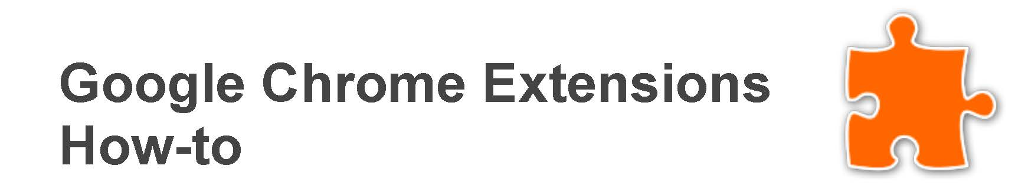


Slide 2


Slide 3


Slide 4
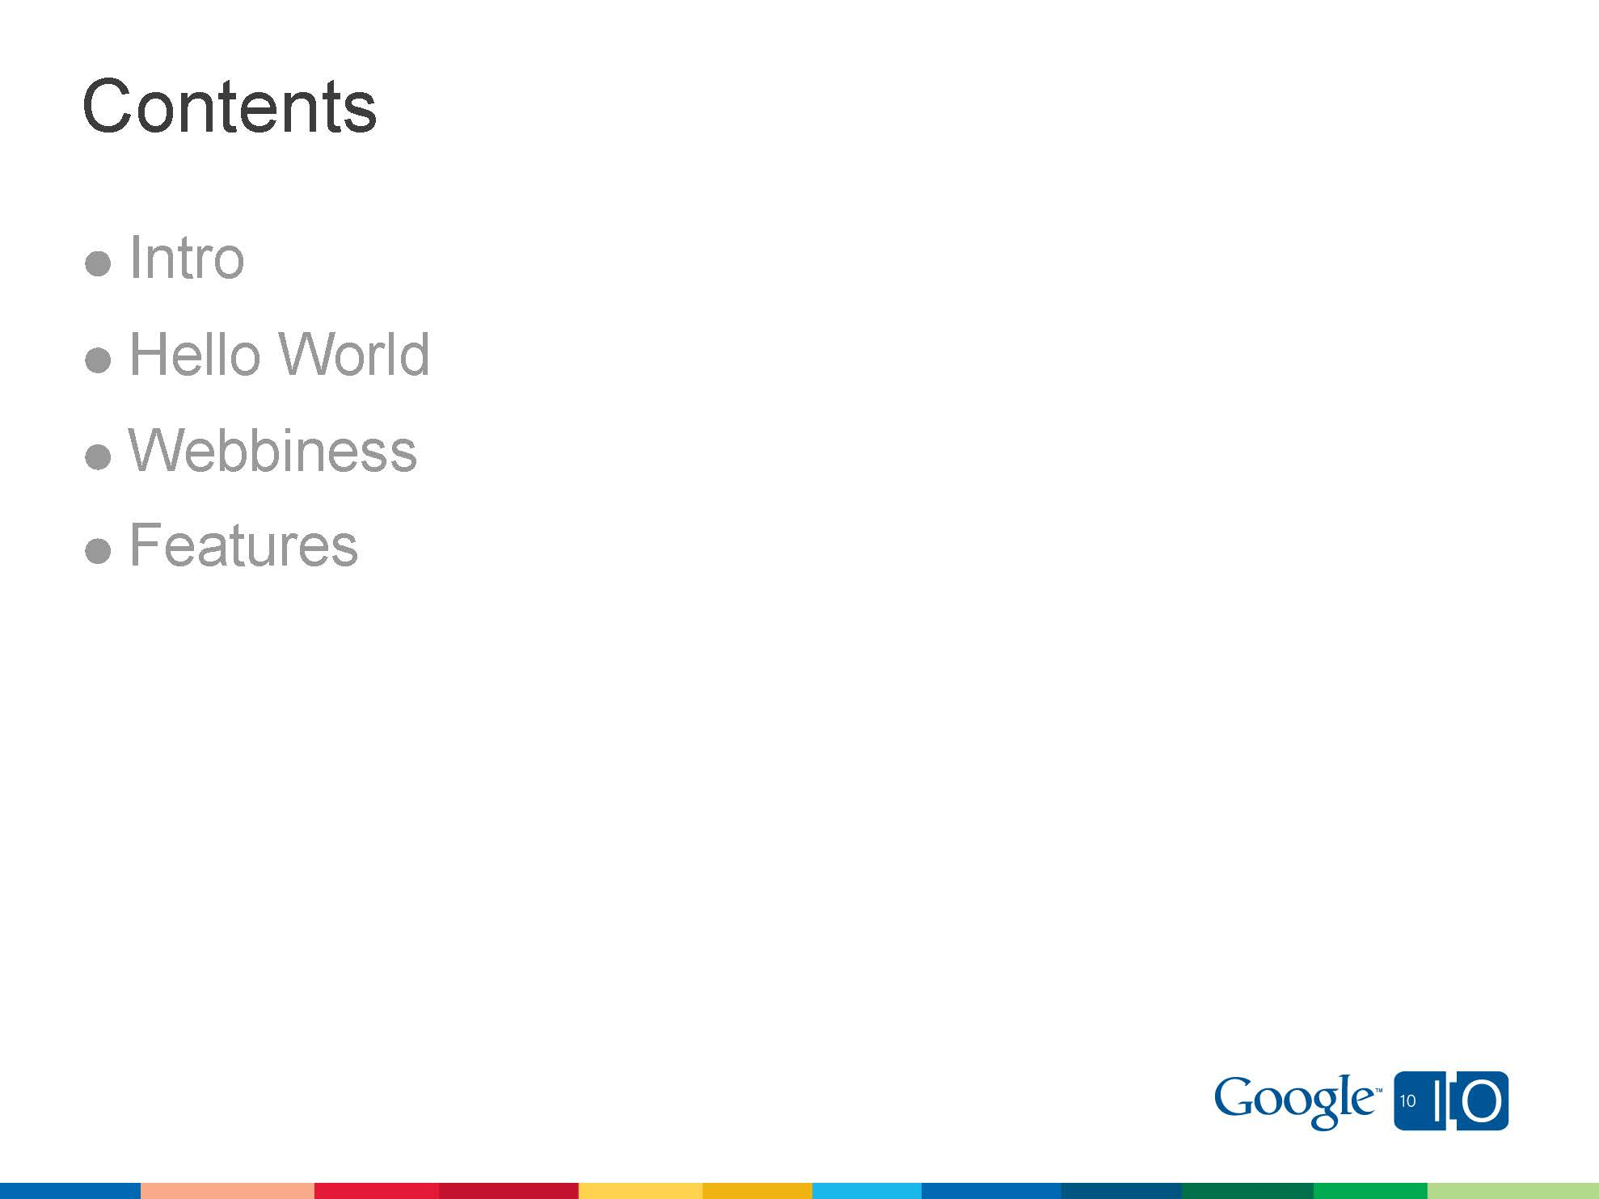

Slide 5
Coding

Slide 6
Coding
Coding

Slide 7
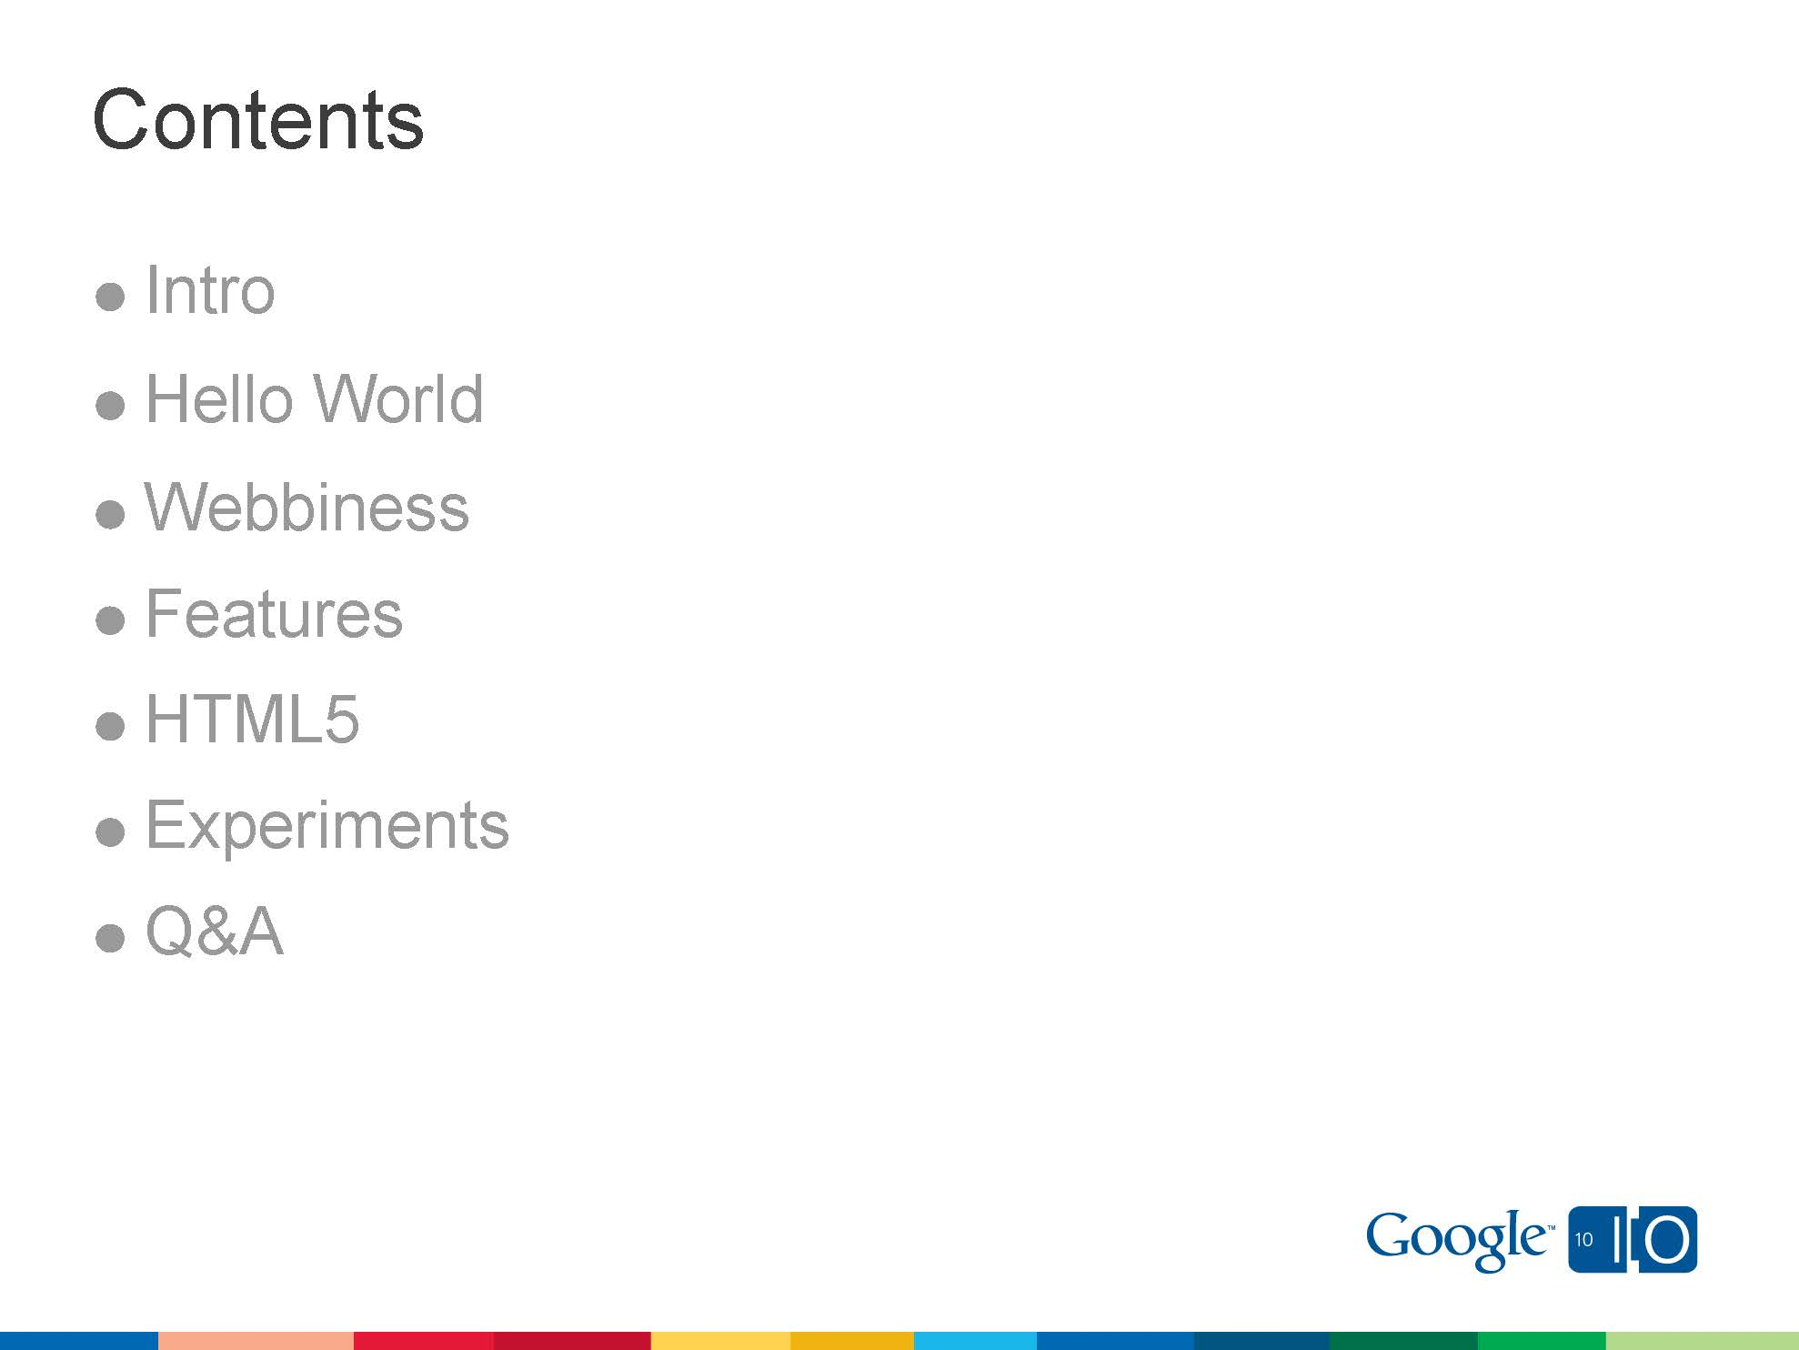
Coding
Coding
Demo

Slide 8
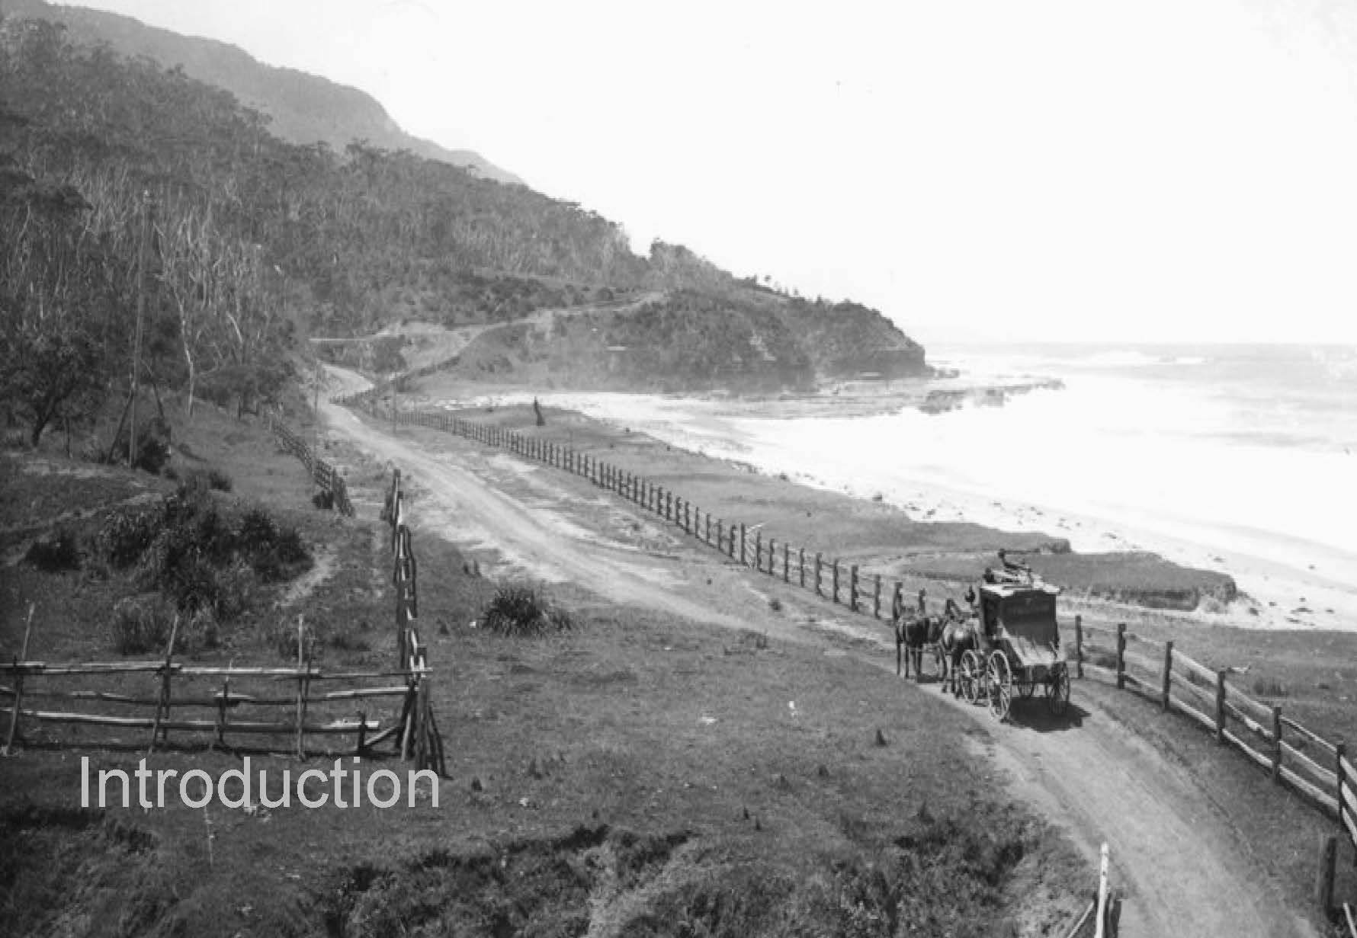

Slide 9
What are Extensions?
Extensions are extra features and functionality that you can easily add to Google Chrome.

Slide 10
What are Extensions?
Extensions are extra features and functionality that you can easily add to Google Chrome.
By using extensions, you can customize Google Chrome with features you like, while keeping your browser free of things that you don't use.

Slide 11
Why we need Extensions

Slide 12
Why we need Extensions
Enhancing the usability of Chrome by adding (or removing) many features to it.

Slide 13
Why we need Extensions
Enhancing the usability of Chrome by adding (or removing) many features to it.
Change the way we surf the websites by organizing stuff according to user`s wish.

Slide 14
Why we need Extensions
Enhancing the usability of Chrome by adding (or removing) many features to it.
Change the way we surf the websites by organizing stuff according to user`s wish.
Blocking unwanted things like advertisements, popups, etc.

Slide 15
Why we need Extensions
Enhancing the usability of Chrome by adding (or removing) many features to it.
Change the way we surf the websites by organizing stuff according to user`s wish.
Blocking unwanted things like advertisements, popups, etc.
Change the look of websites and browser.

Slide 16
Why we need Extensions
Enhancing the usability of Chrome by adding (or removing) many features to it.
Change the way we surf the websites by organizing stuff according to user`s wish.
Blocking unwanted things like advertisements, popups, etc.
Change the look of websites and browser.
Sharing and bookmarking information in a much easier way.

Slide 17
Why we need Extensions
Enhancing the usability of Chrome by adding (or removing) many features to it.
Change the way we surf the websites by organizing stuff according to user`s wish.
Blocking unwanted things like advertisements, popups, etc.
Change the look of websites and browser.
Sharing and bookmarking information in a much easier way.
Desktop Notifications and much More….!

Slide 18


Slide 19
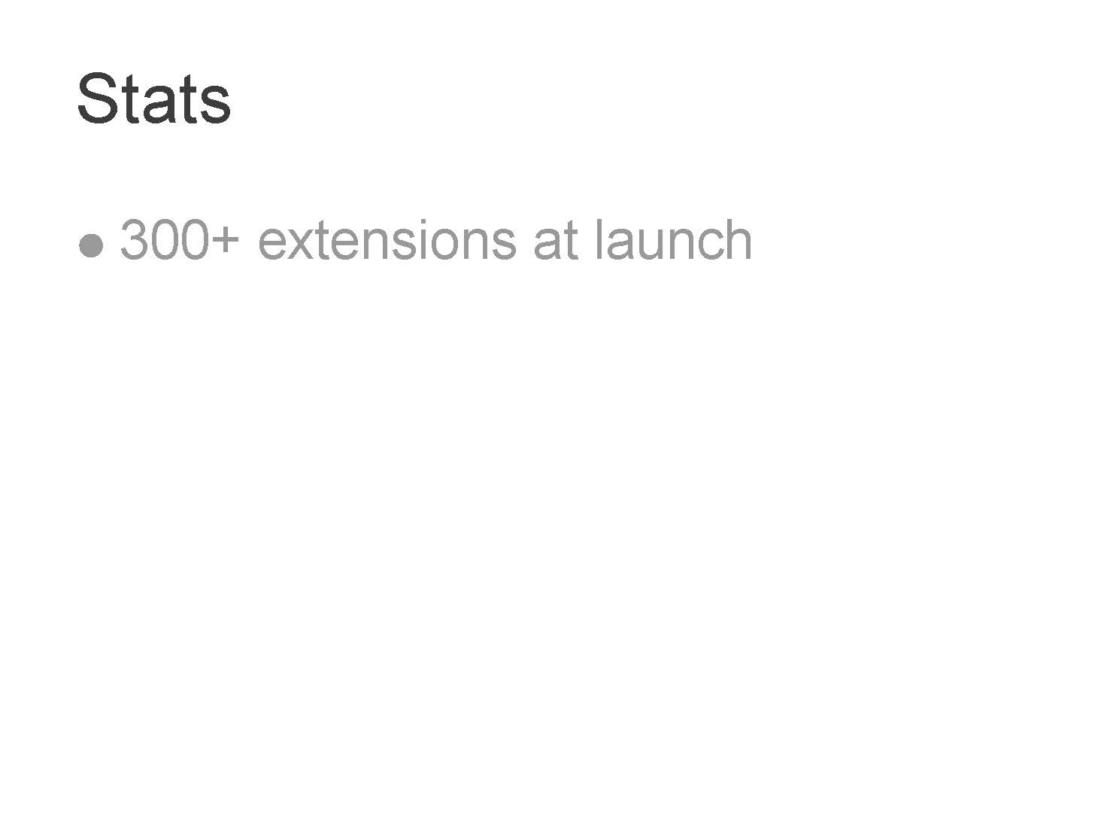

Slide 20
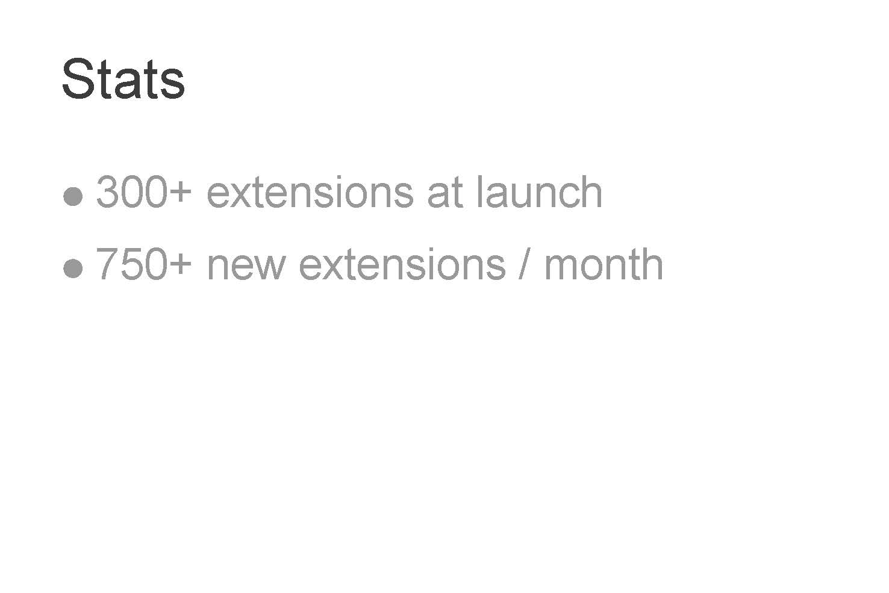

Slide 21
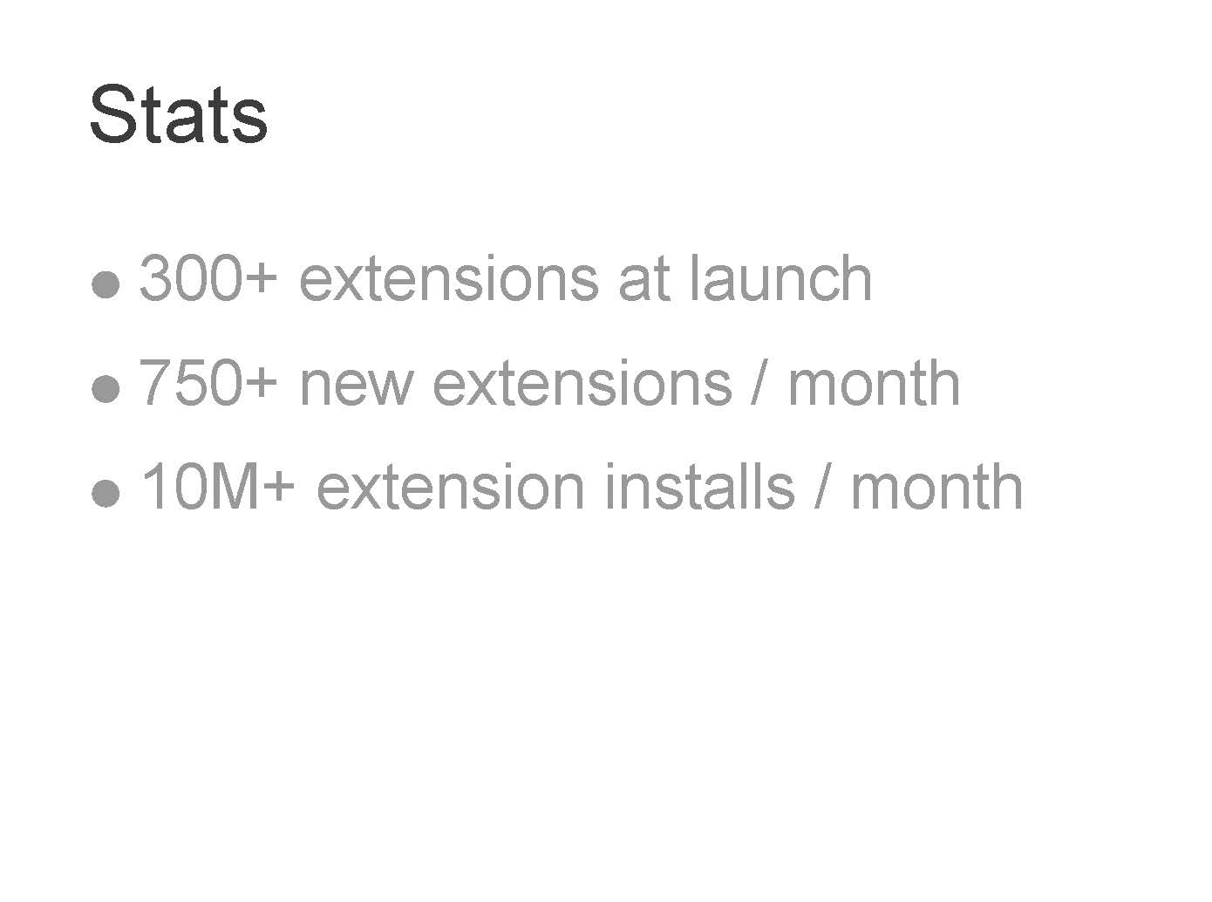

Slide 22
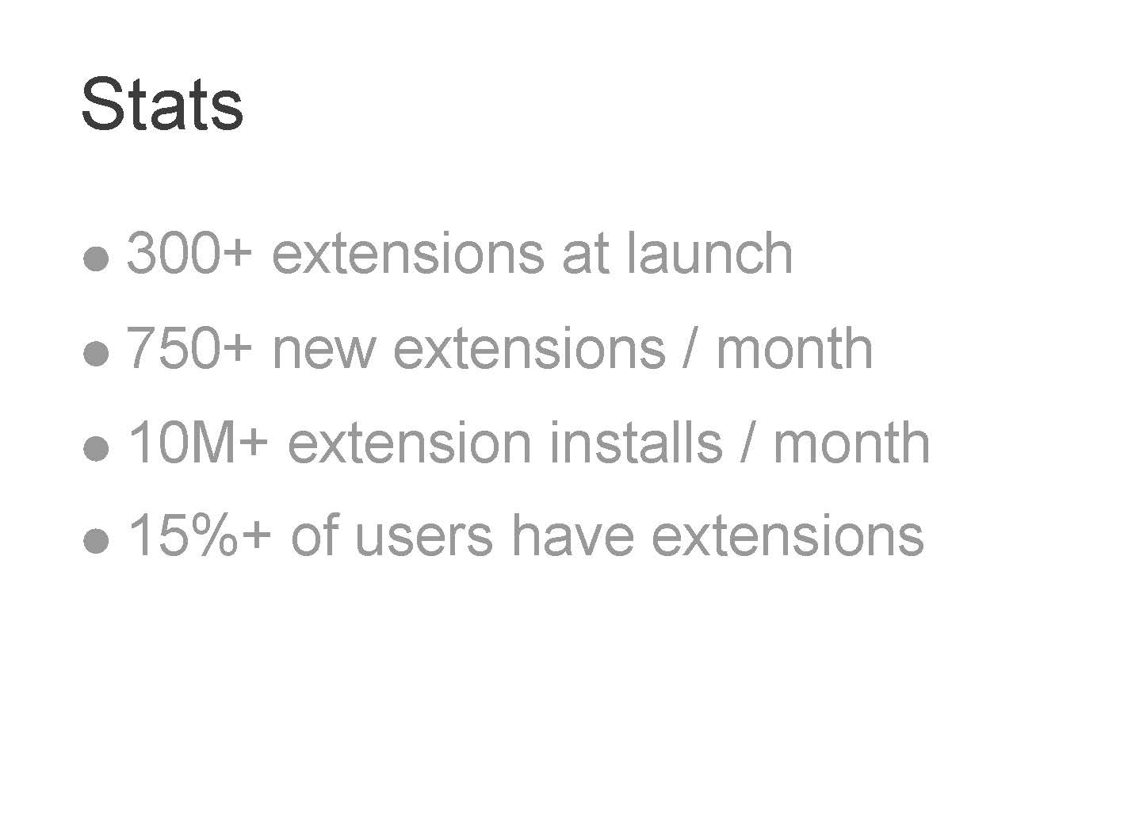

Slide 23


Slide 24


Slide 25


Slide 26
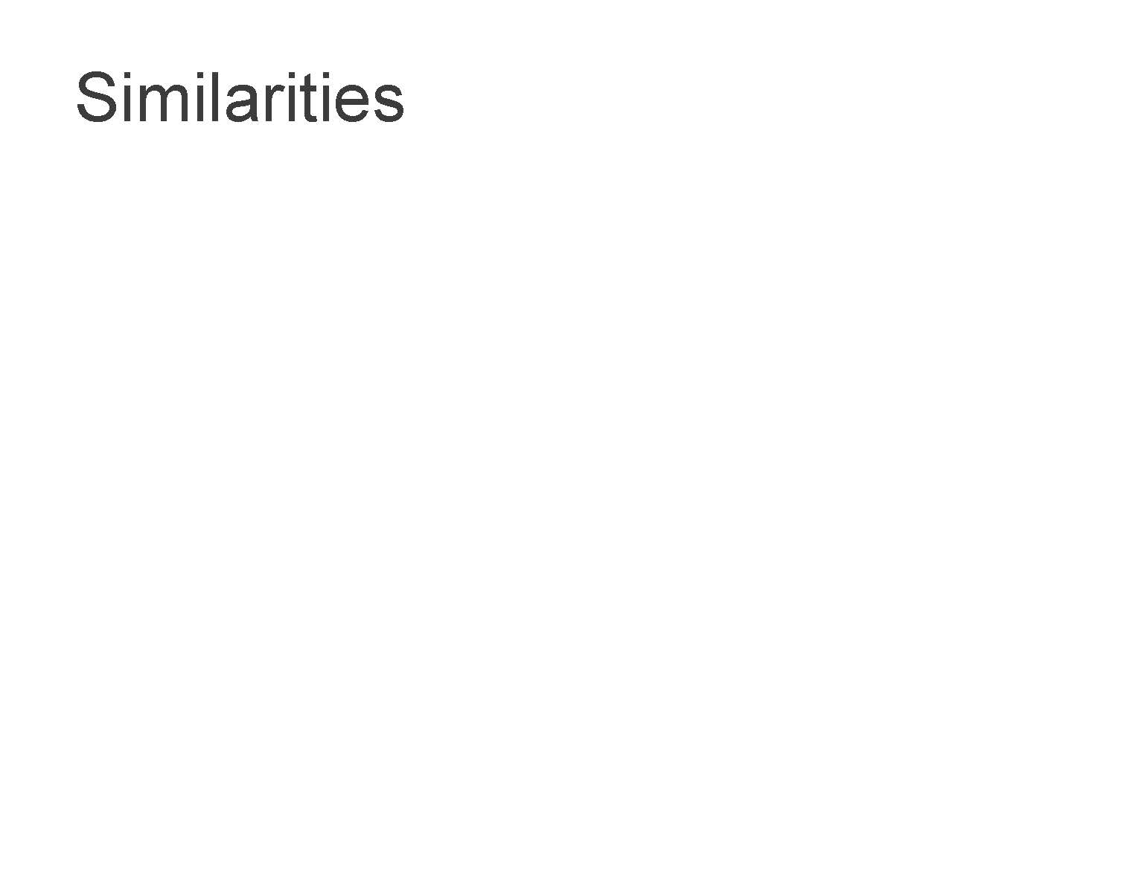

Slide 27
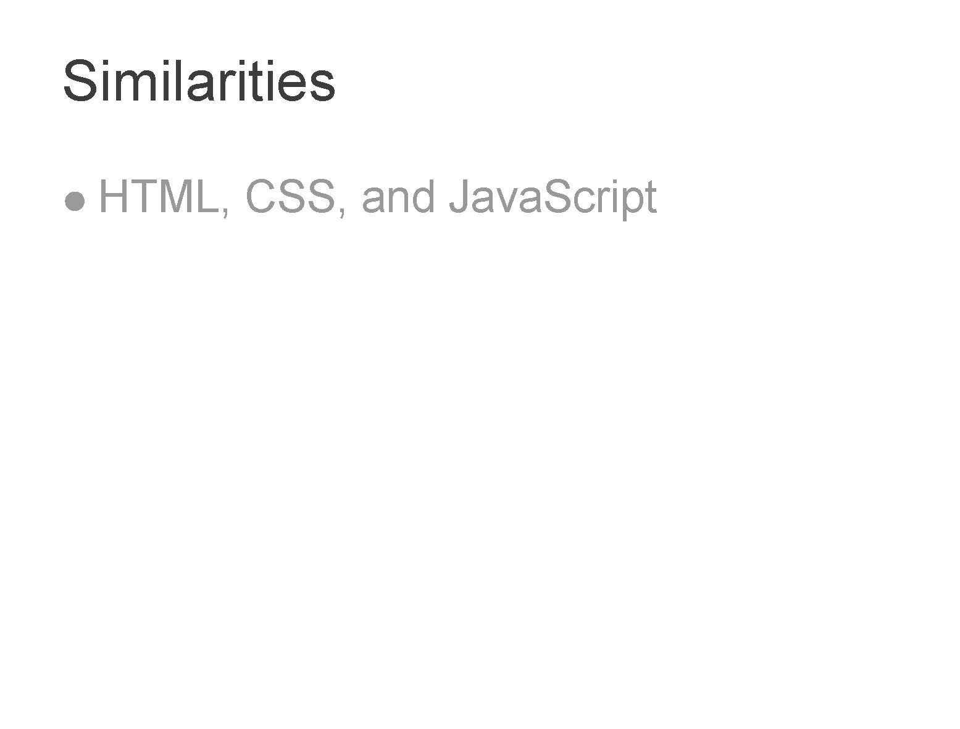

Slide 28
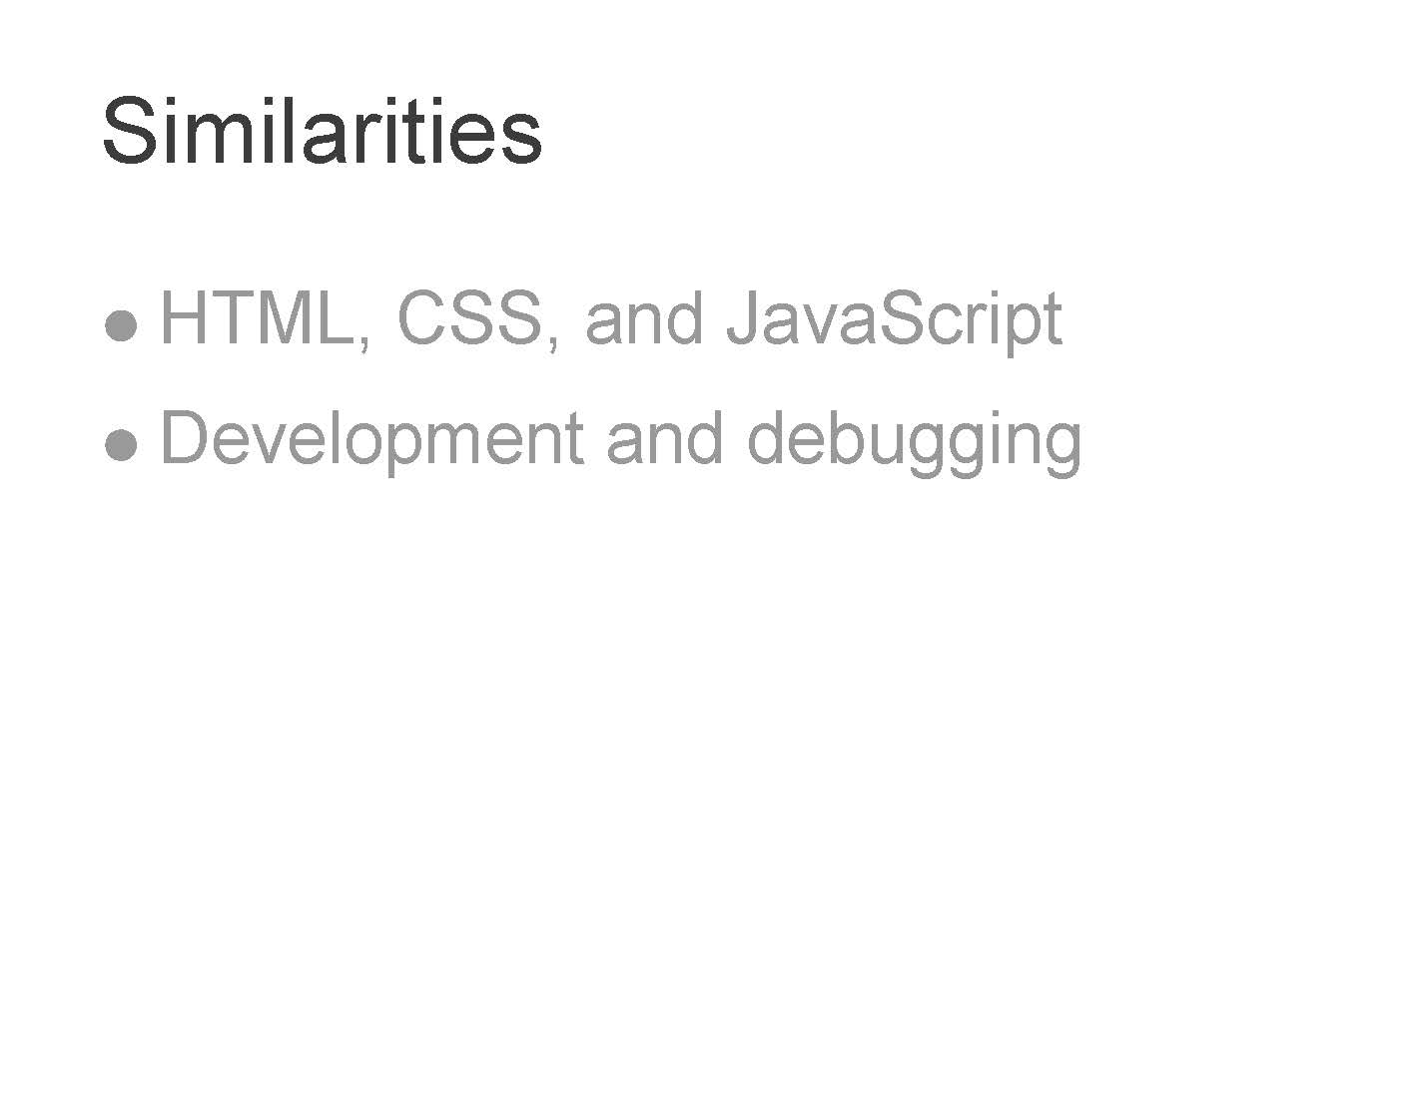

Slide 29
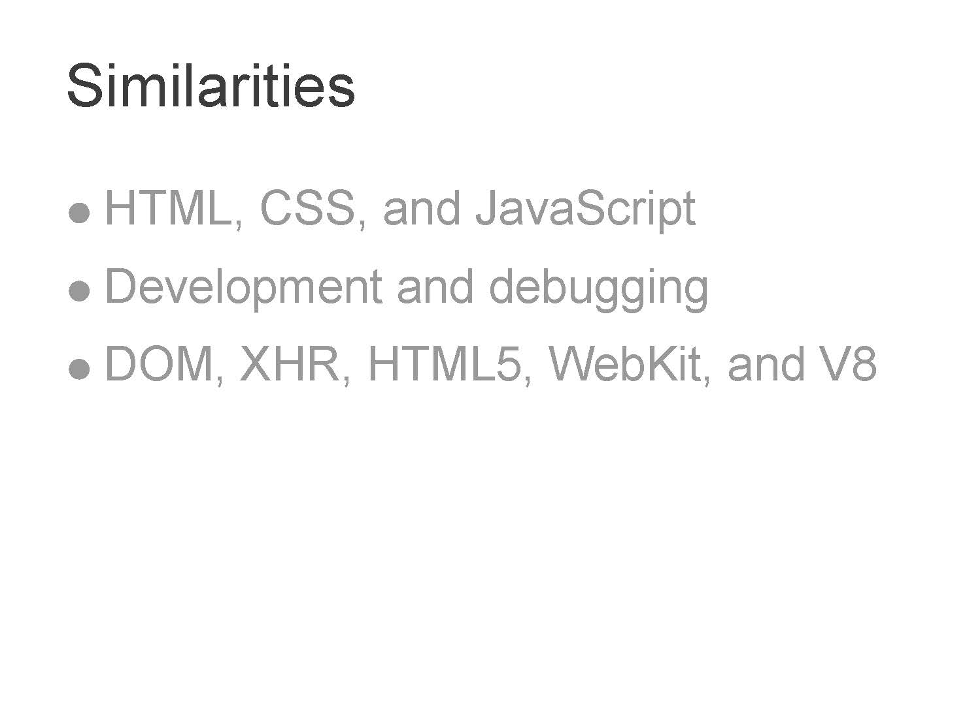

Slide 30
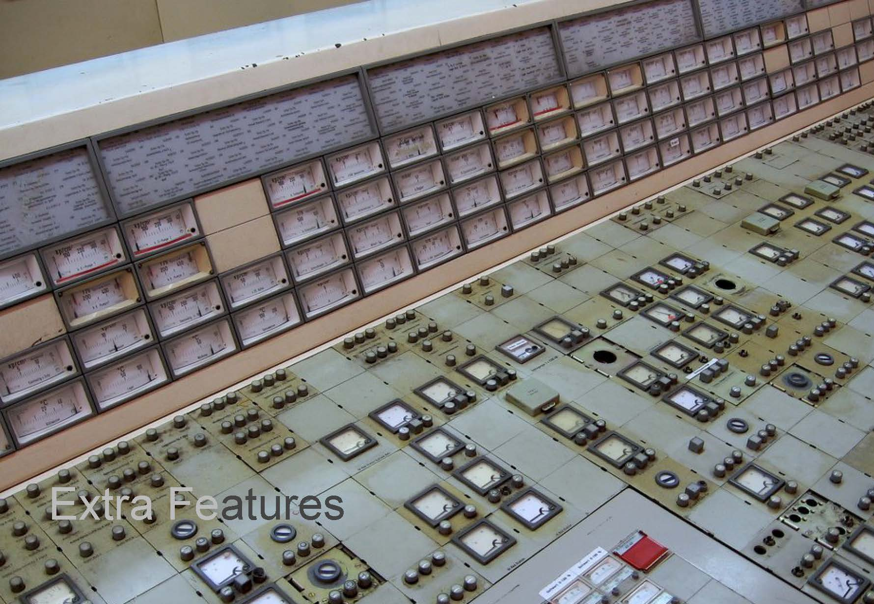

Slide 31
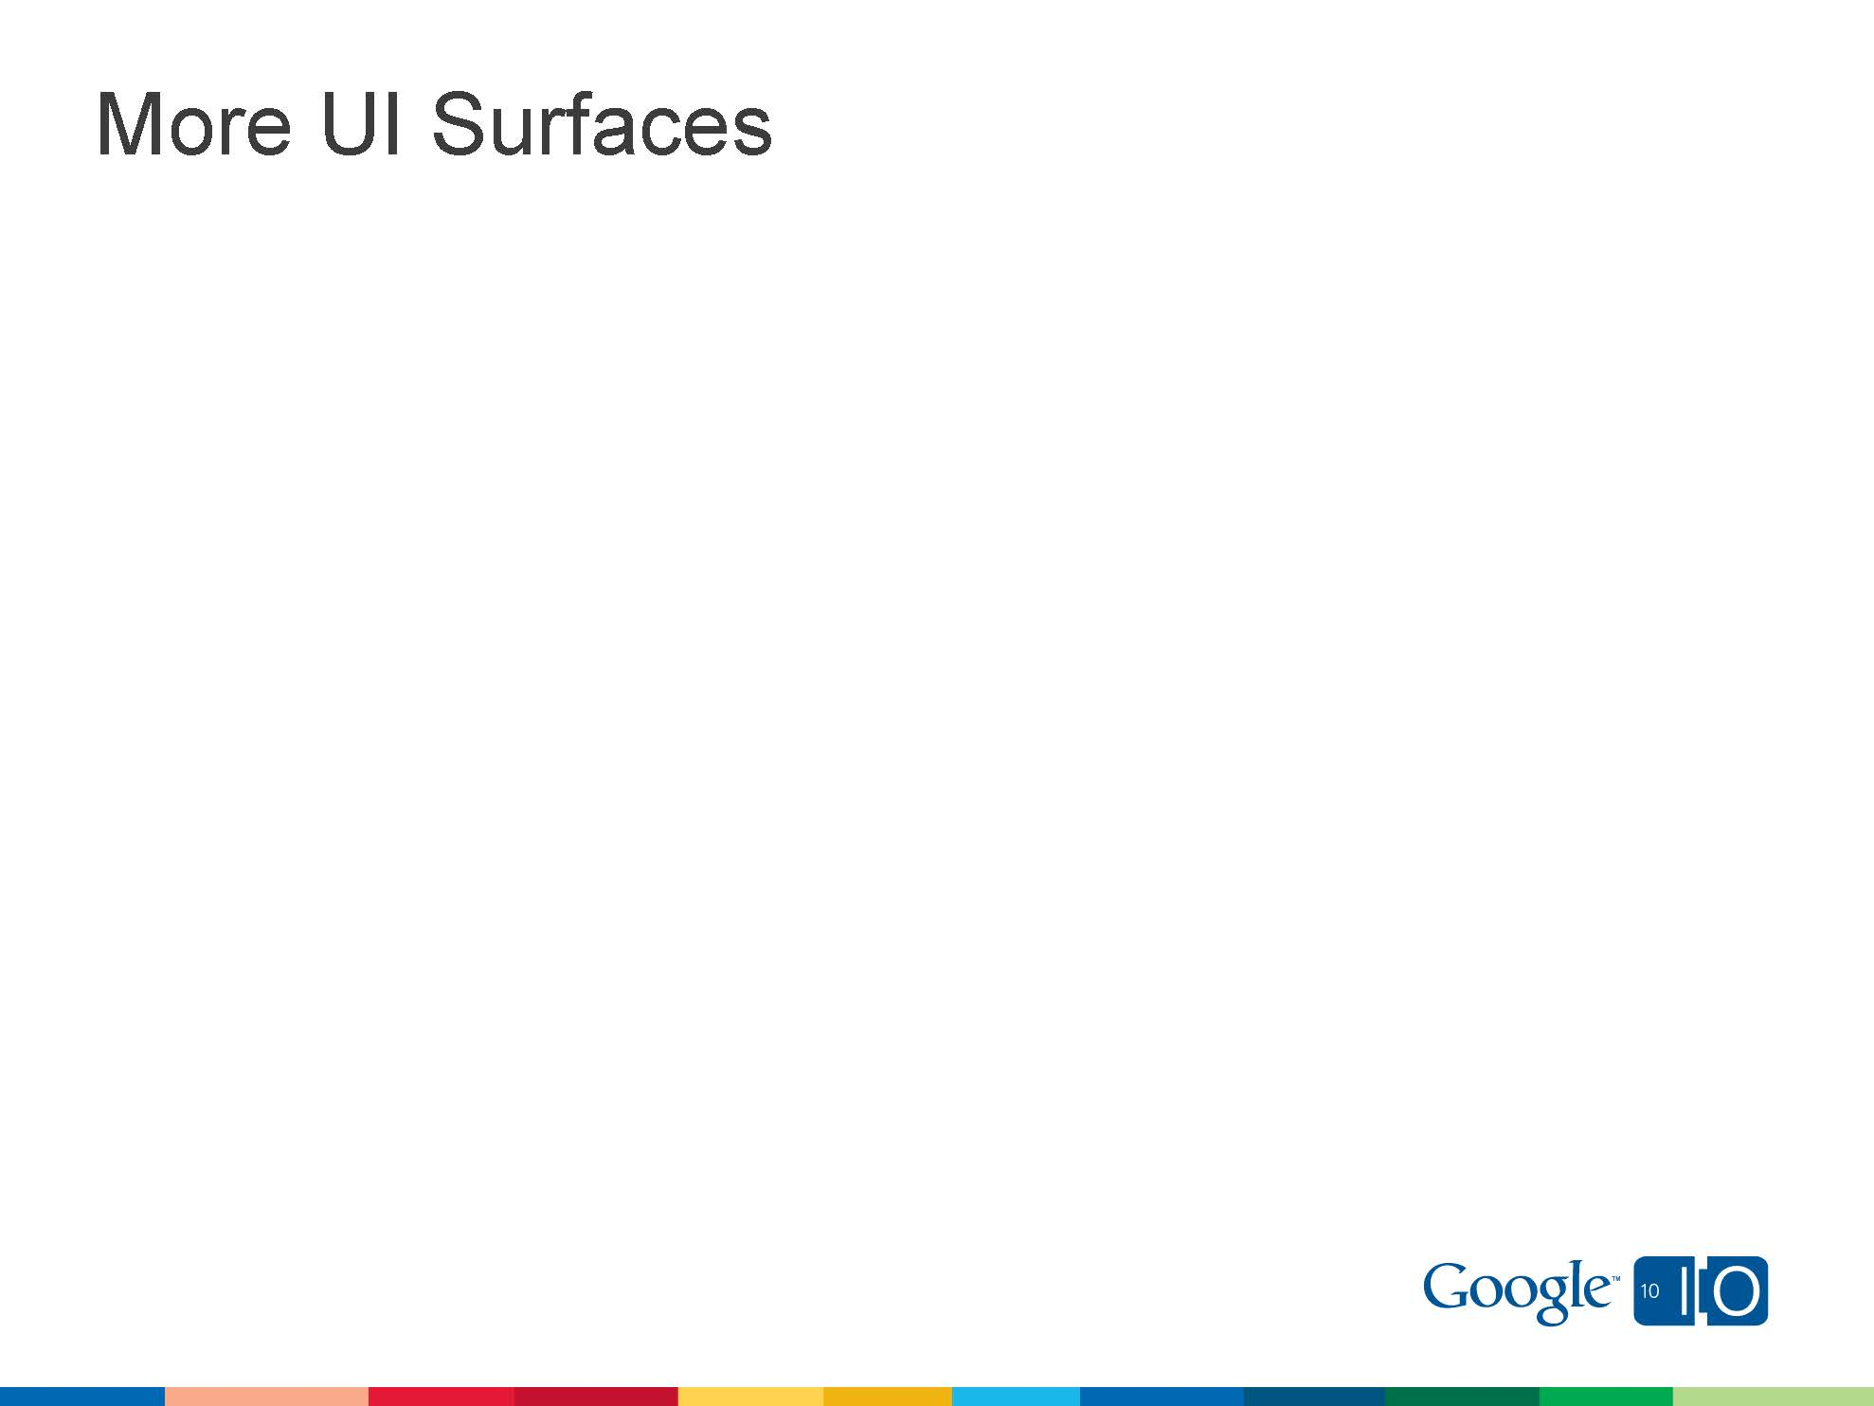

Slide 32
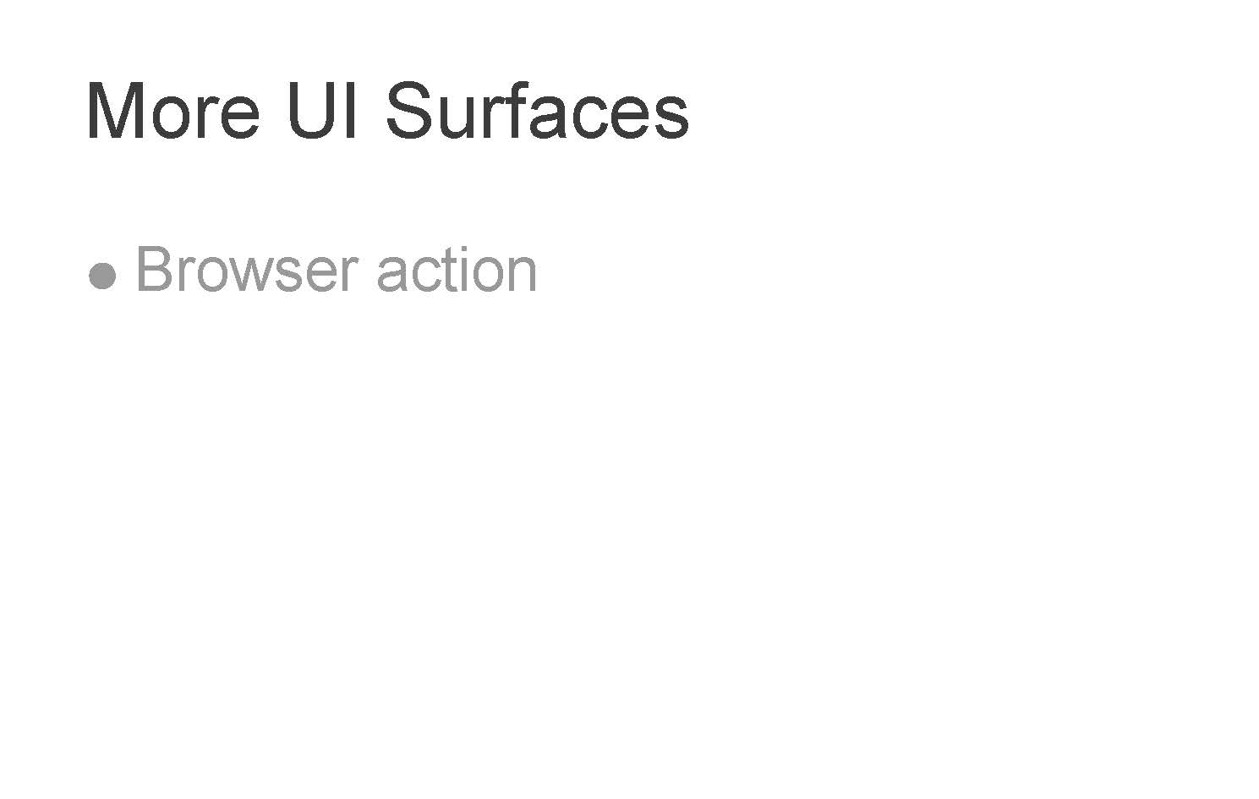

Slide 33
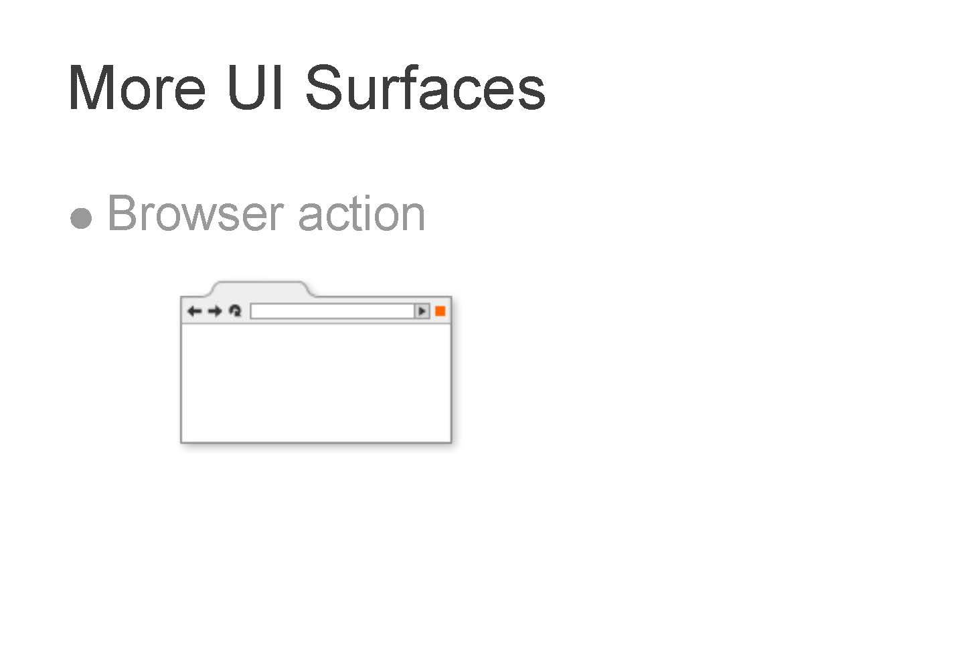

Slide 34
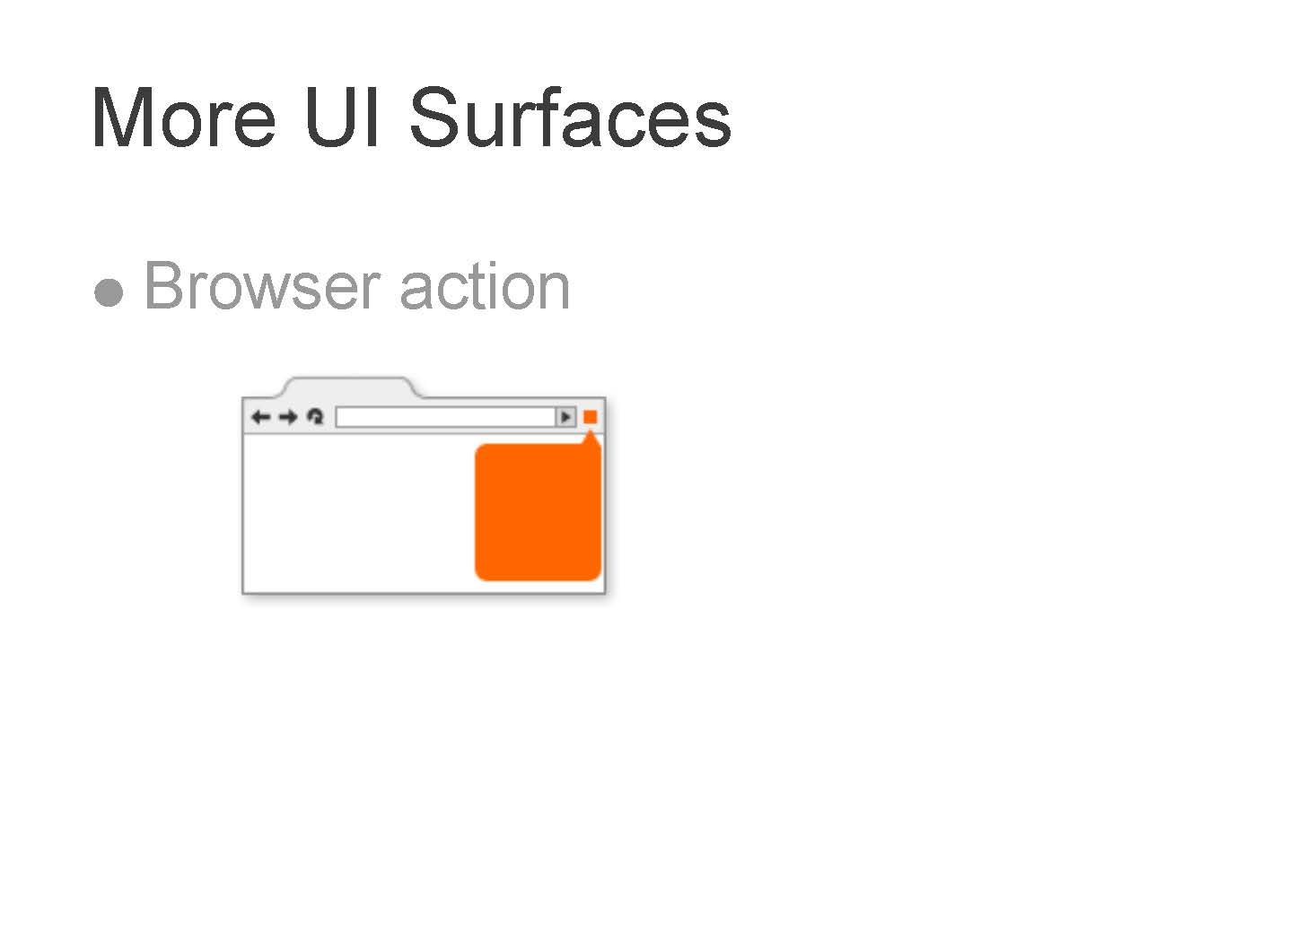

Slide 36
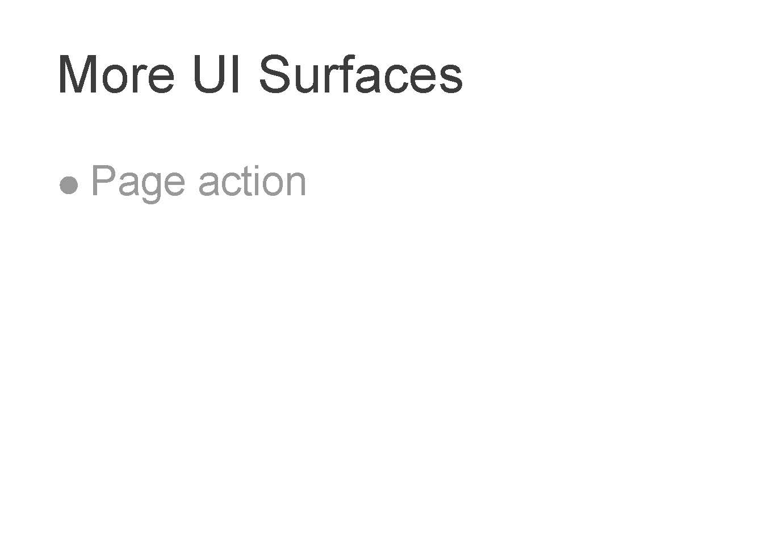

Slide 37


Slide 38


Slide 40


Slide 41
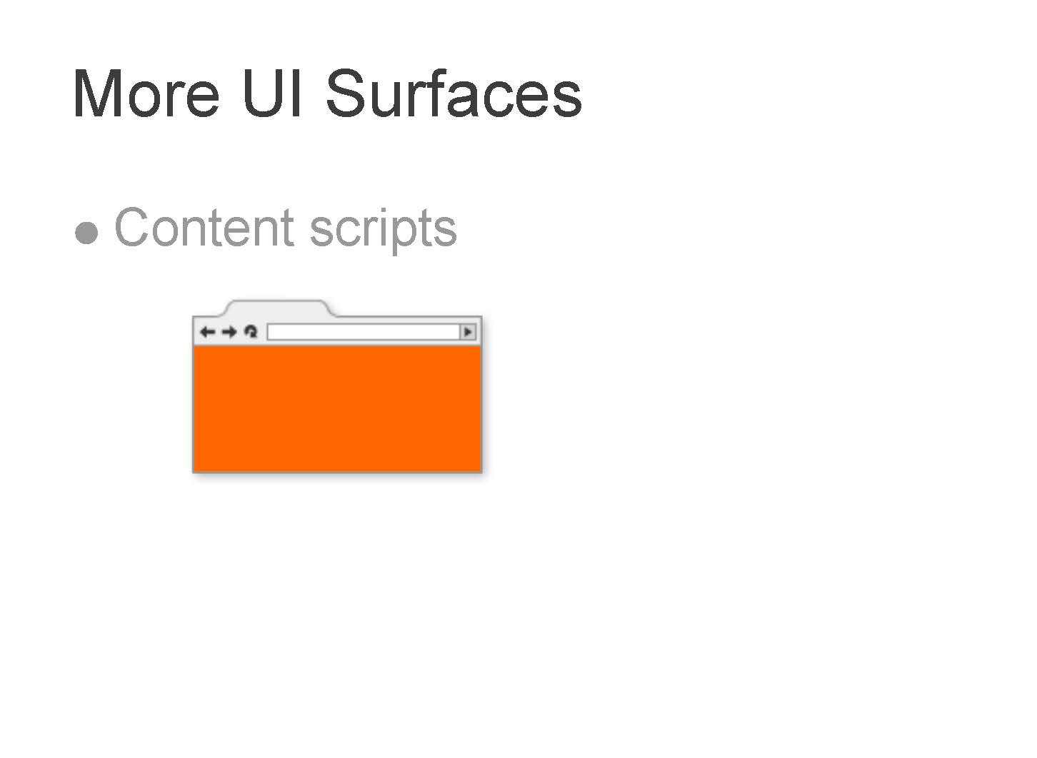

Slide 43
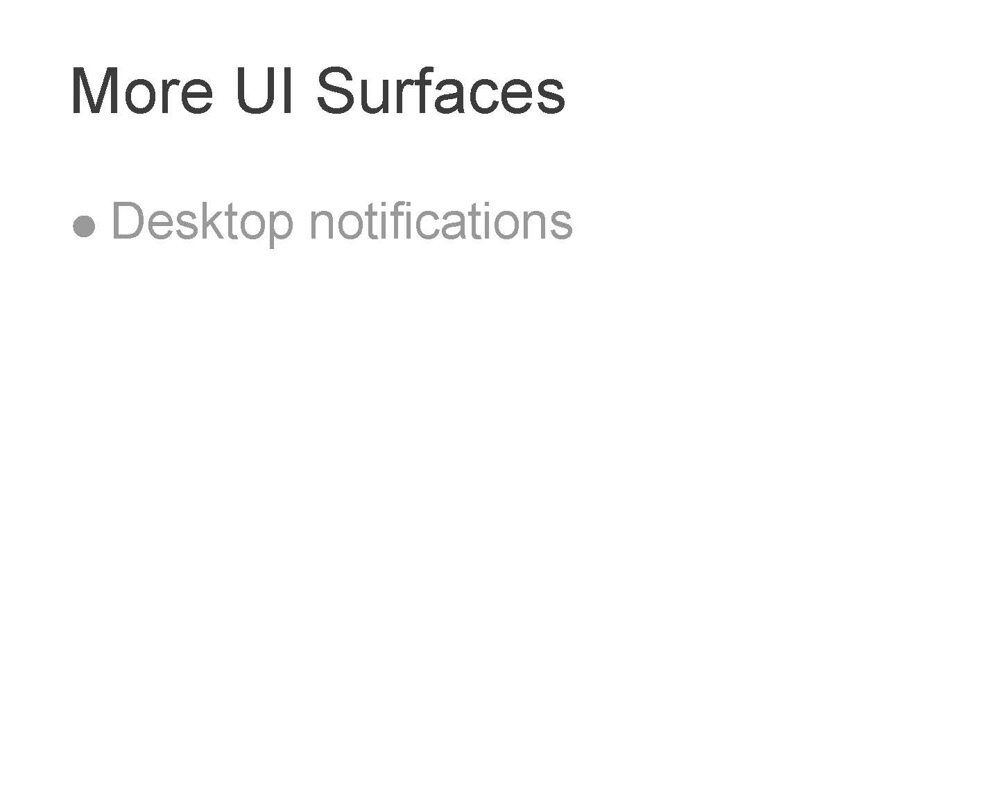

Slide 44
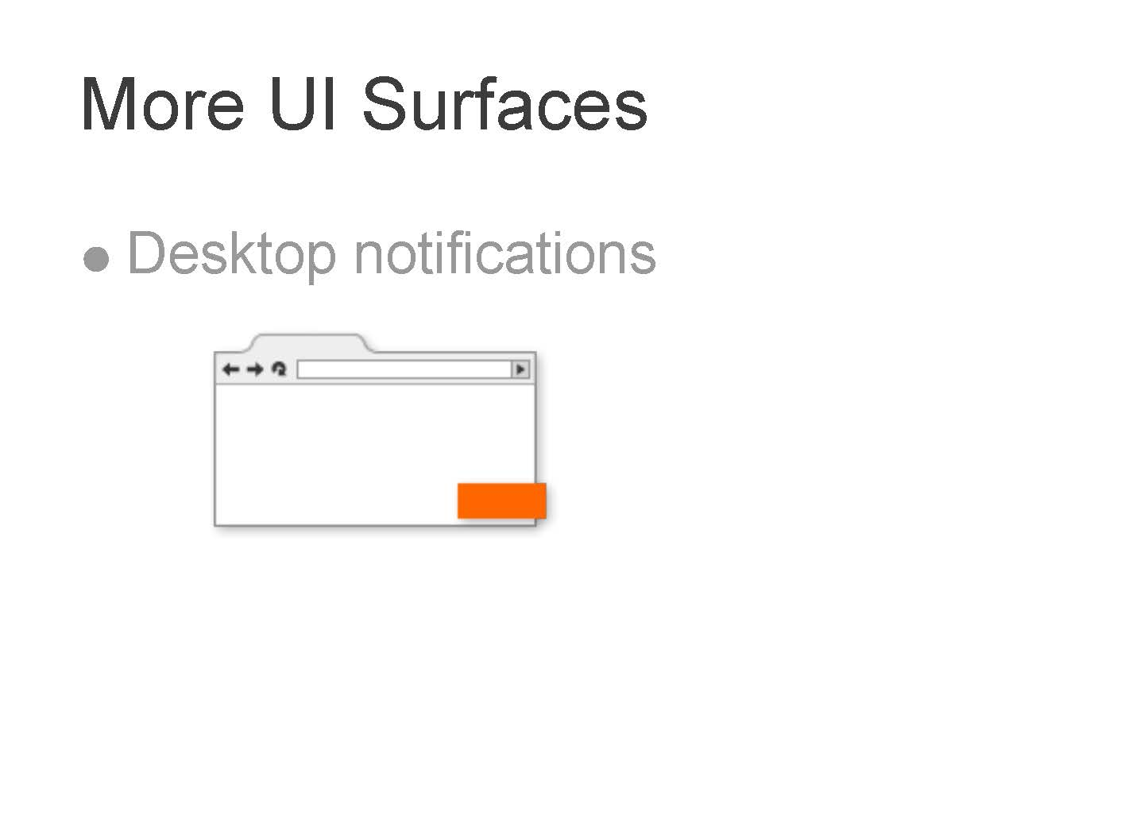

Slide 46


Slide 47
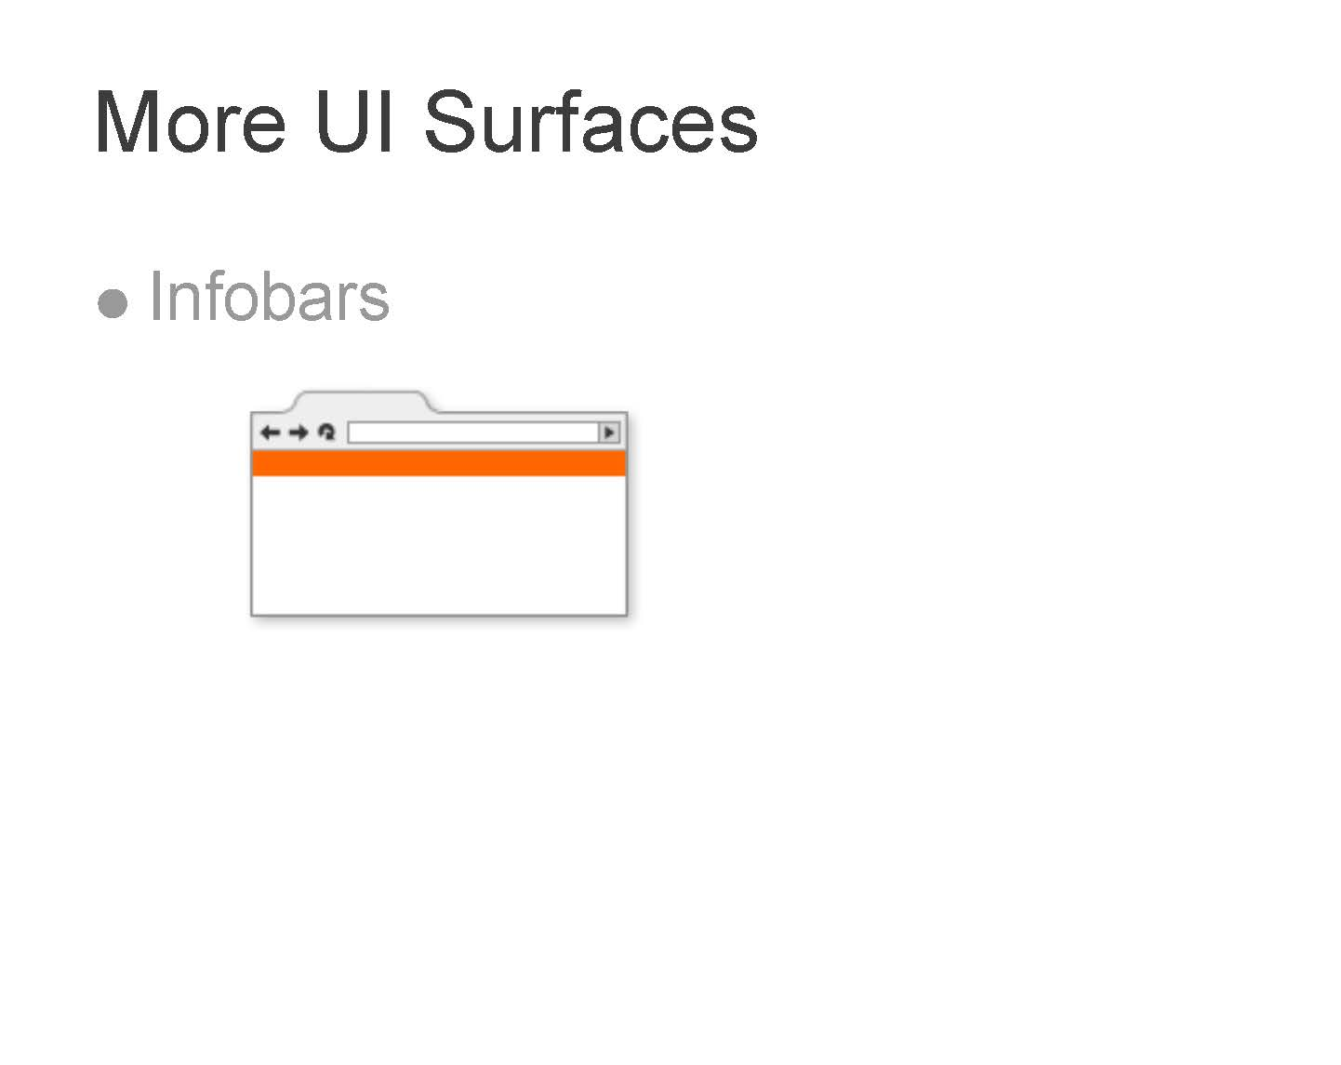

Slide 49


Slide 50
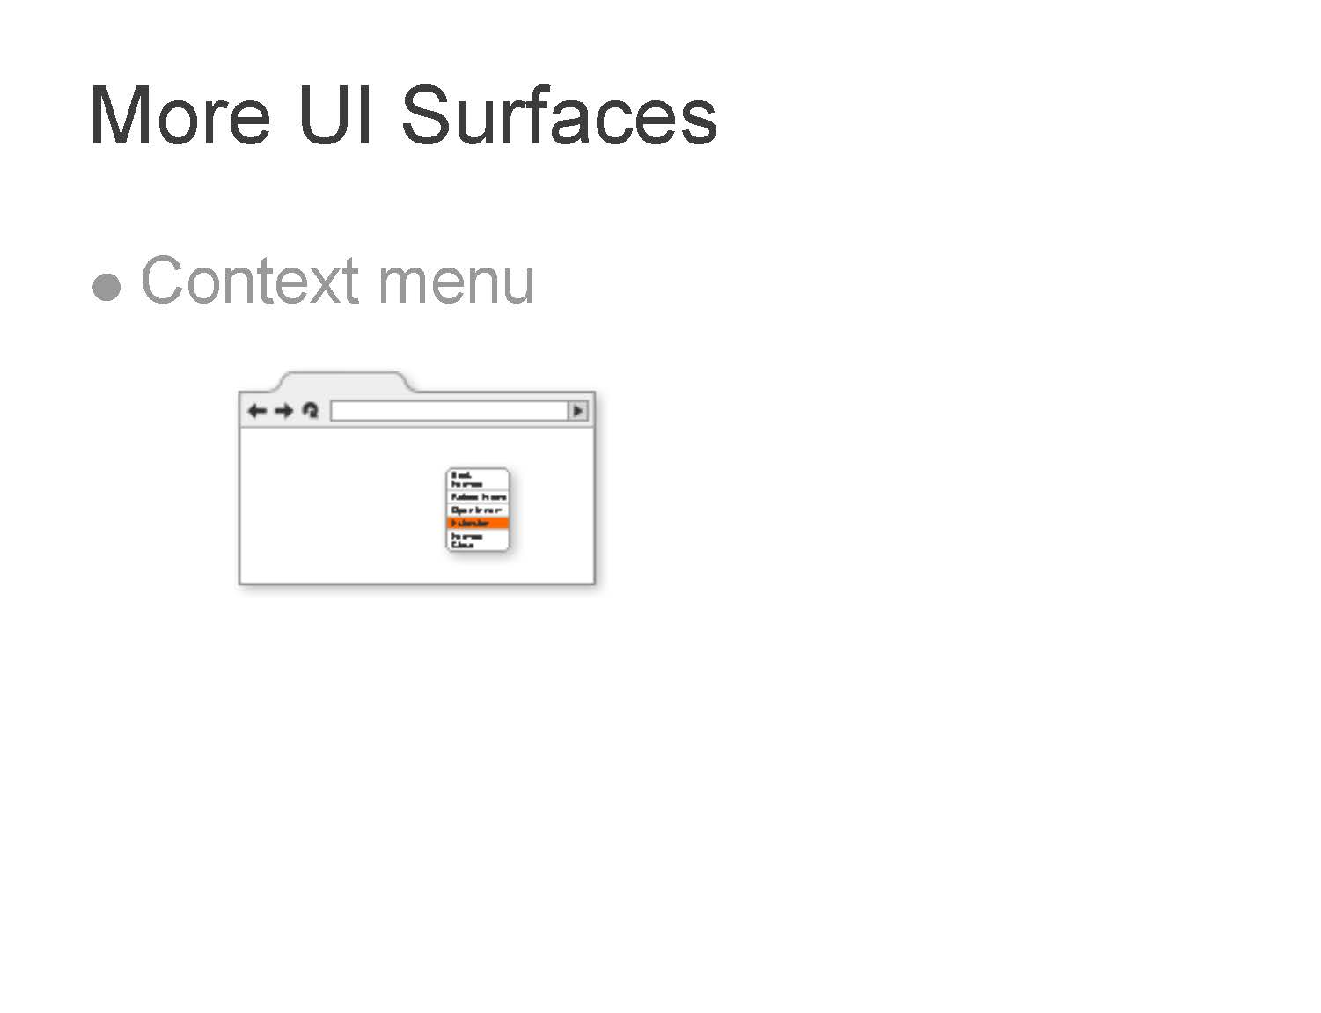

Slide 51

and Coding

Slide 52
Pre-Requisites

Slide 53
Pre-Requisites
You may need the following to start developing a successful chrome extension.
Google Chrome Browser
What else???????????

Slide 54
Pre-Requisites
You may need the following to start developing a successful chrome extension.
Google Chrome Browser
What else???????????
Nothing !

Slide 55
Pre-Requisites
You may need the following to start developing a successful chrome extension.
Google Chrome Browser
Knowledge required:
• HTML

Slide 56
Pre-Requisites
You may need the following to start developing a successful chrome extension.
Google Chrome Browser
Knowledge required:
• HTML
• CSS

Slide 57
Pre-Requisites
You may need the following to start developing a successful chrome extension.
Google Chrome Browser
Knowledge required:
• HTML
• CSS
• JAVASCRIPT

Slide 58
Pre-Requisites
You may need the following to start developing a successful chrome extension.
Google Chrome Browser
Knowledge required:
• HTML
• CSS
• JAVASCRIPT
• GOOGLE CHROME EXTENSION API

Slide 59
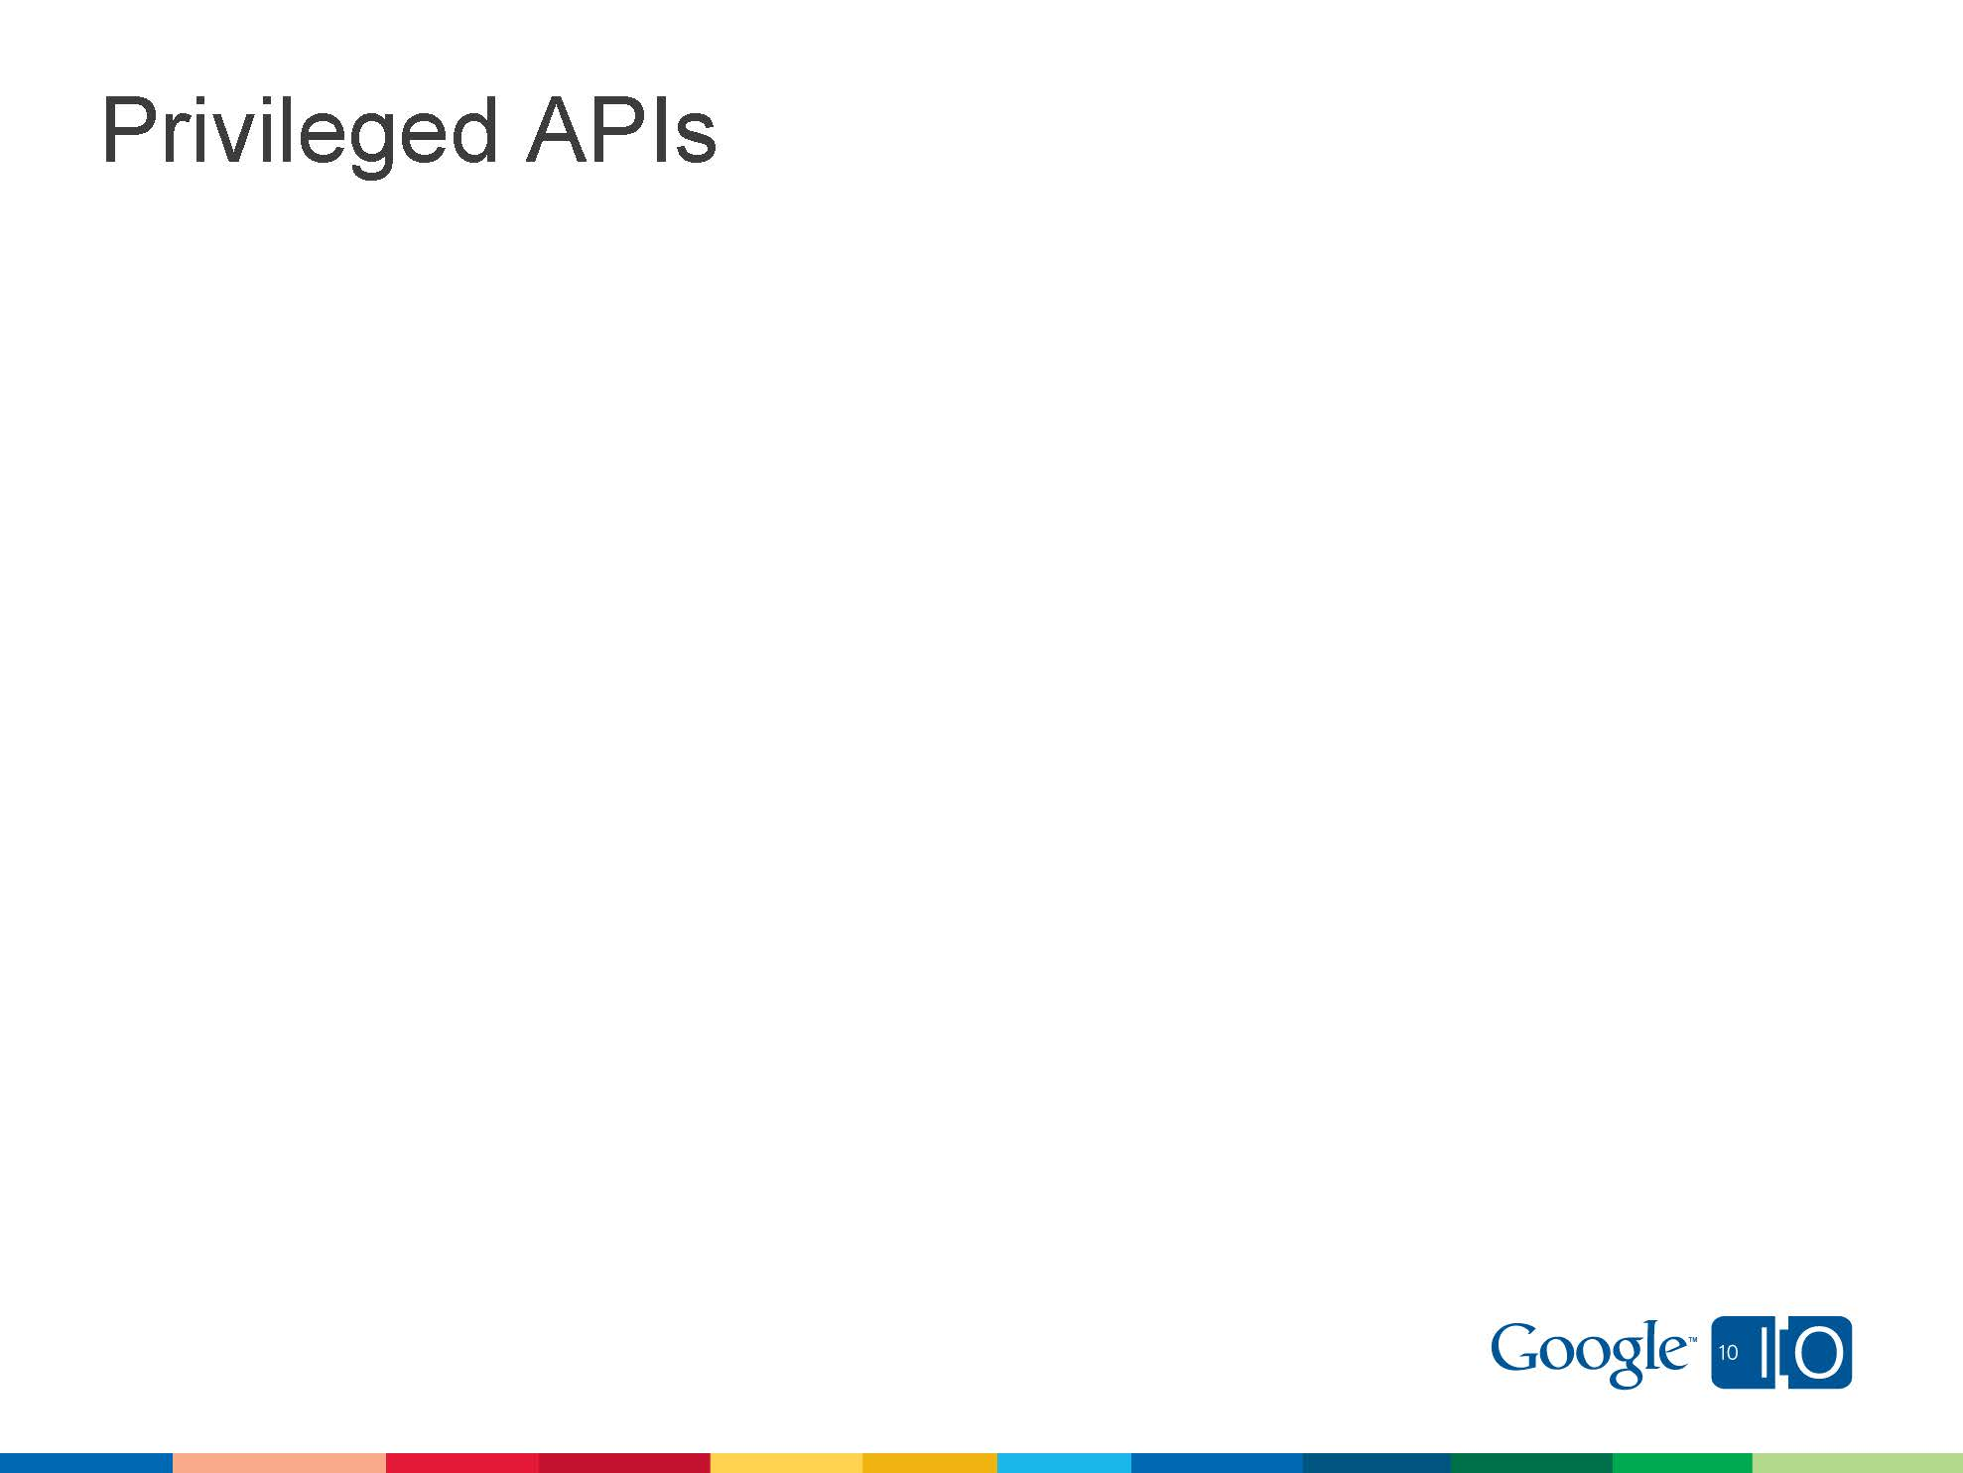

Slide 60
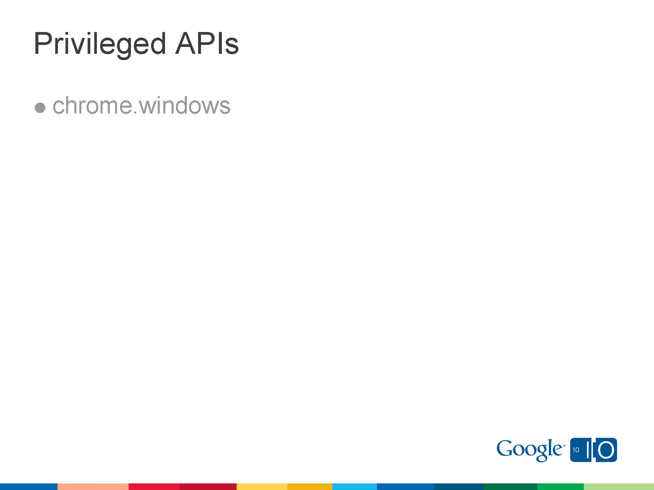

Slide 61
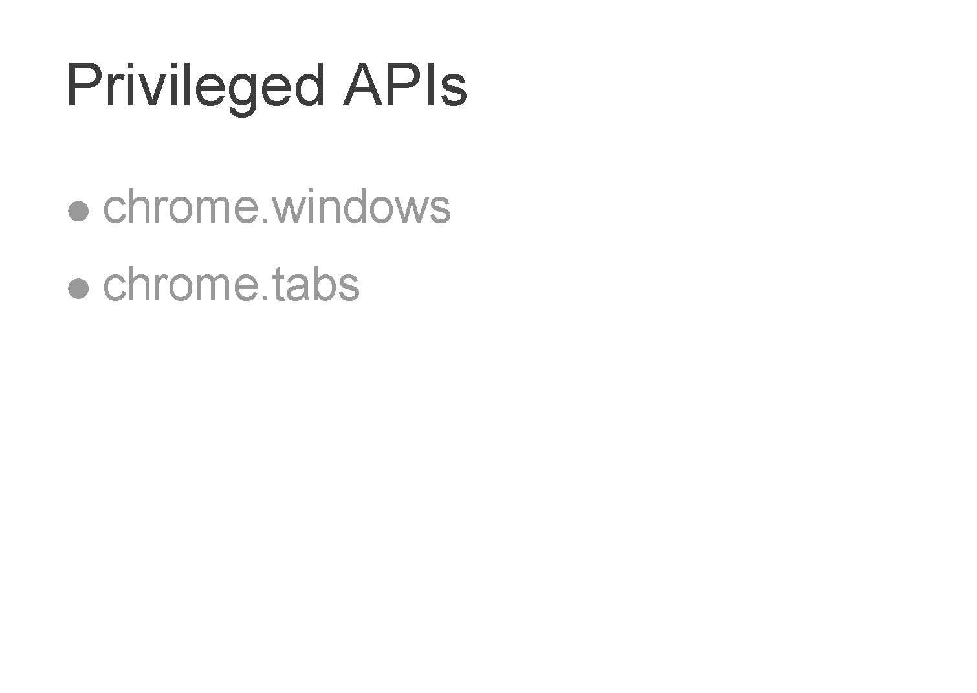

Slide 62
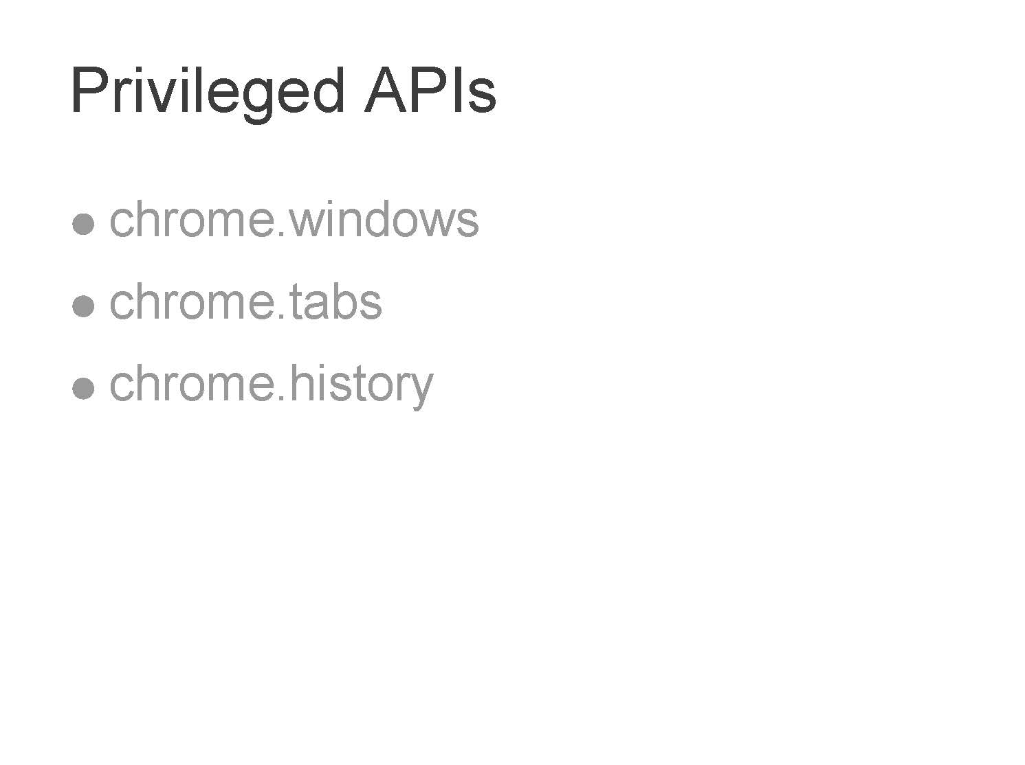

Slide 63
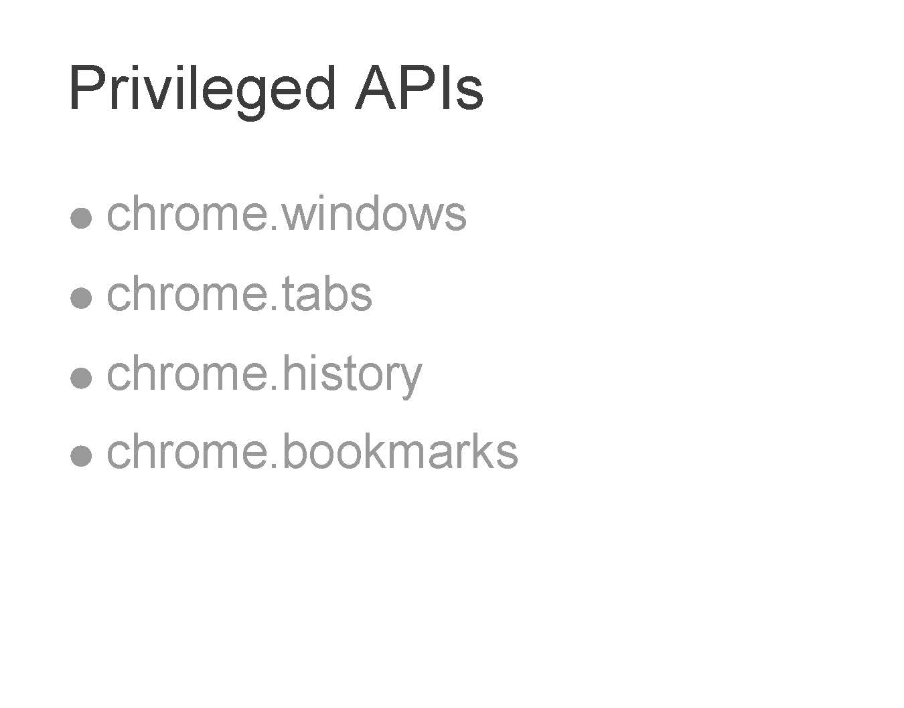

Slide 65
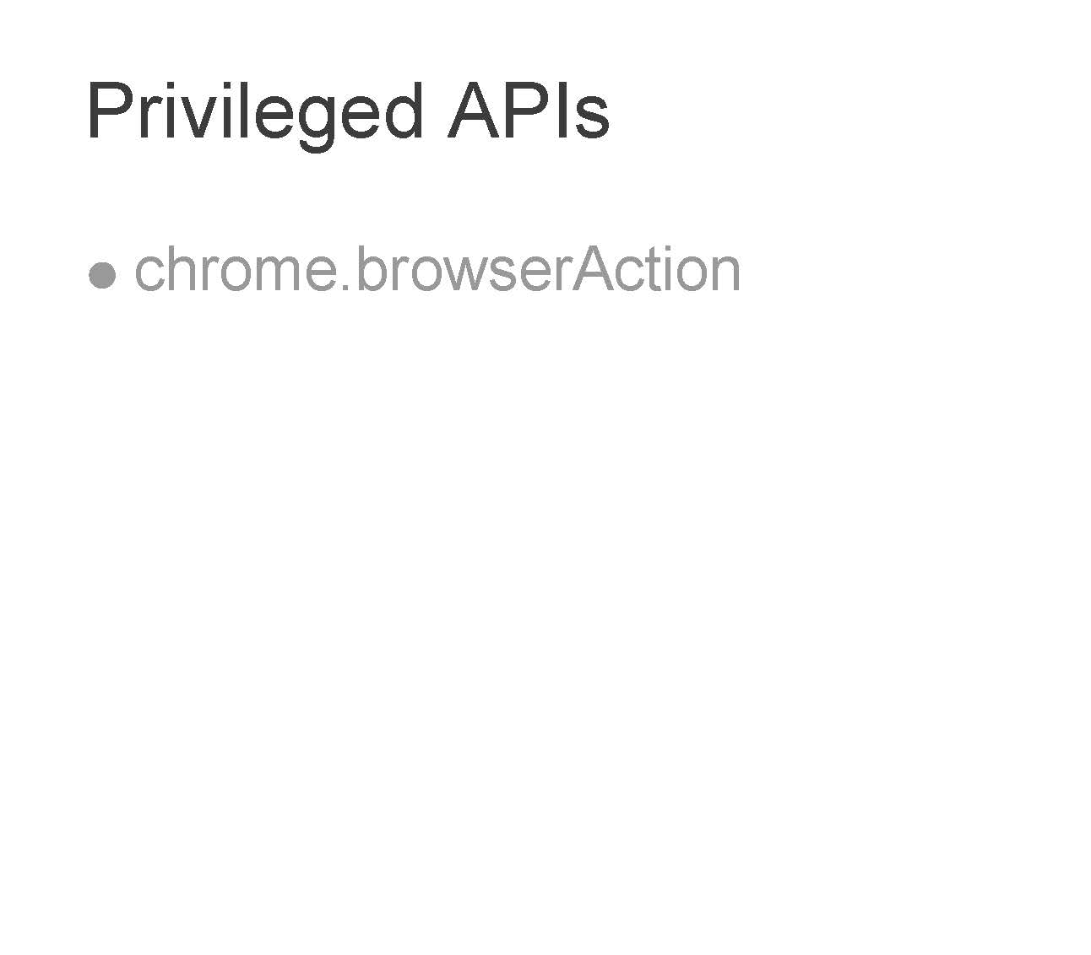

Slide 66
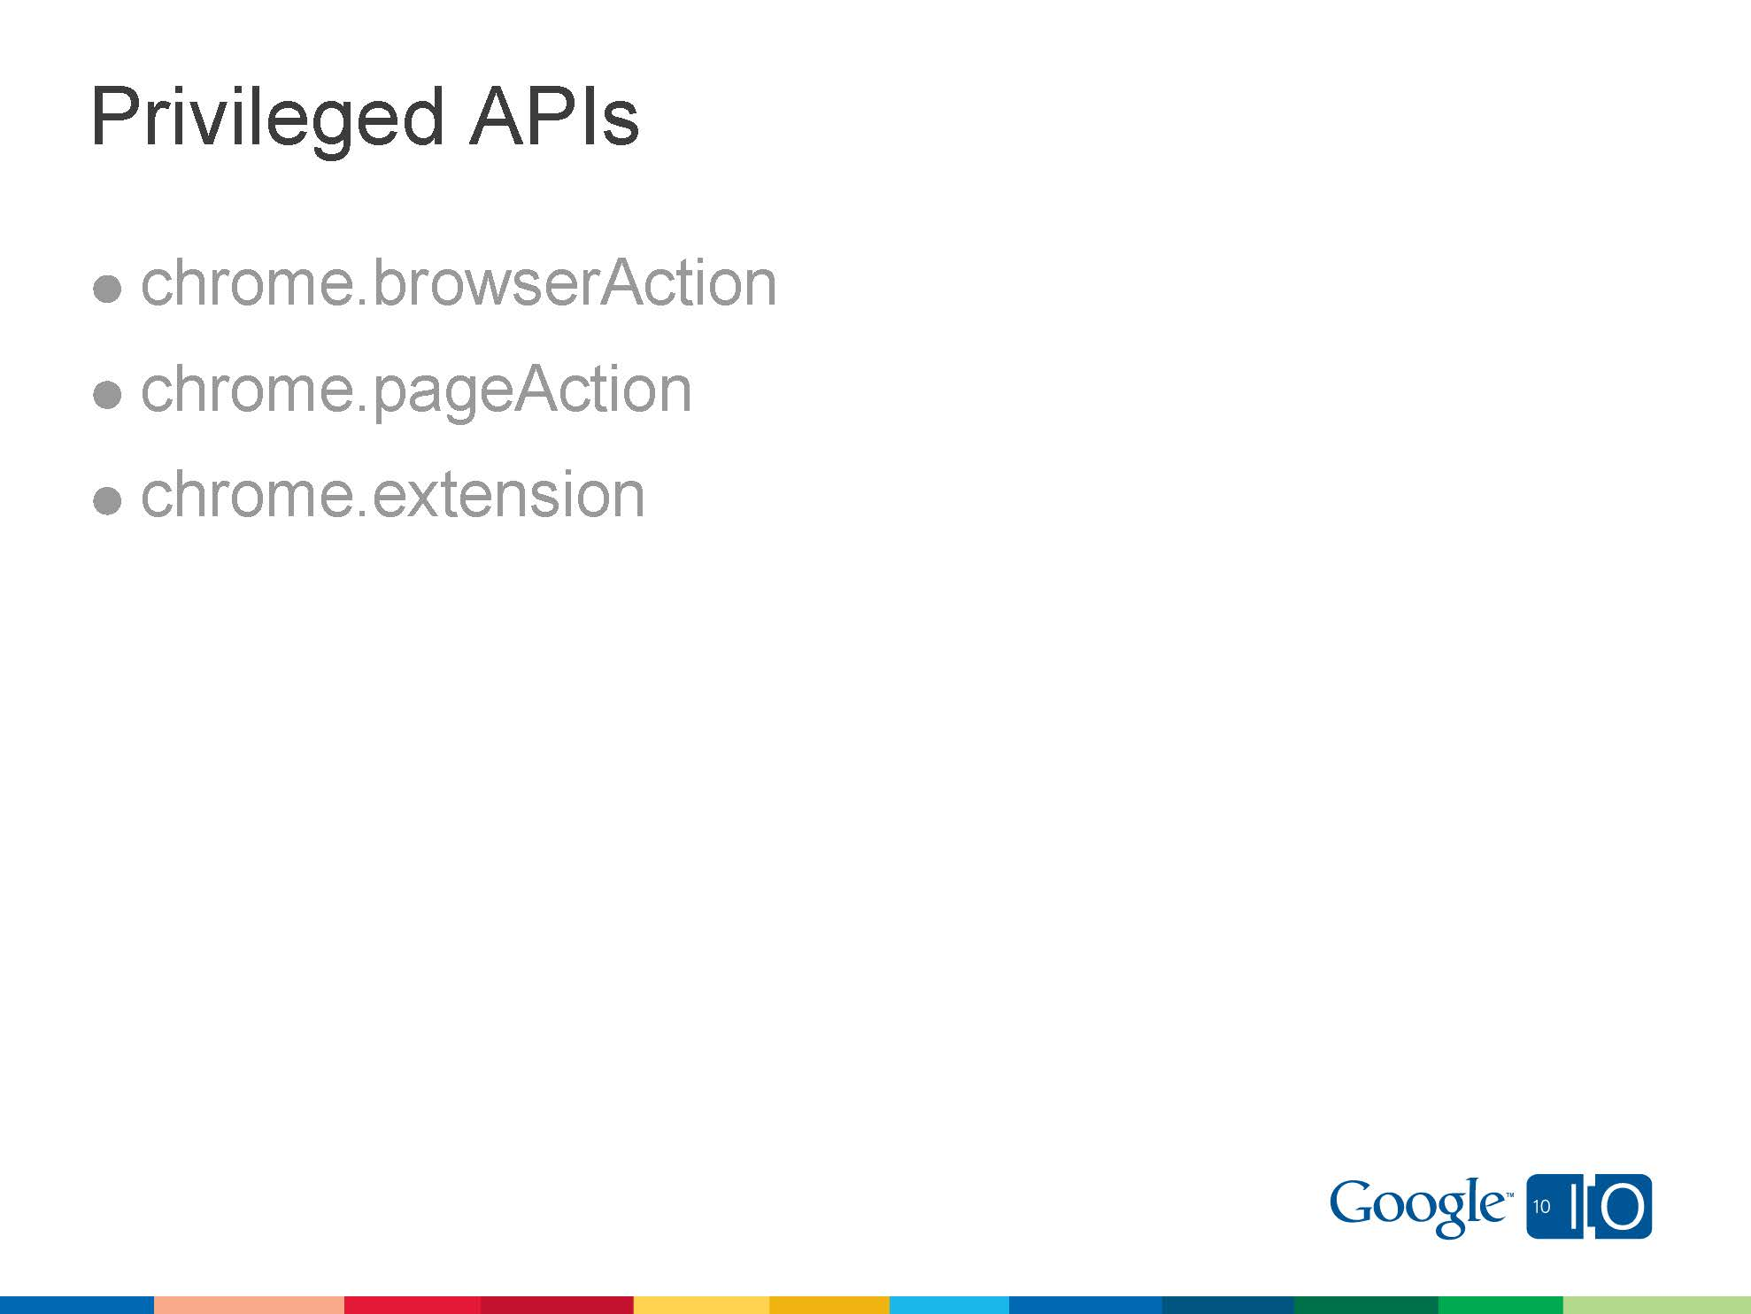

Slide 68
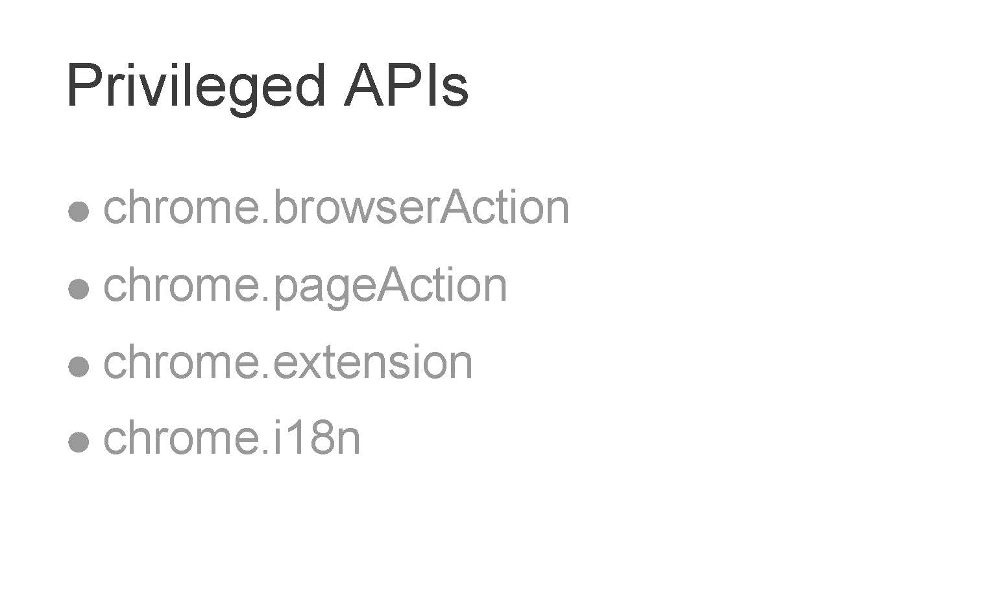

Slide 69
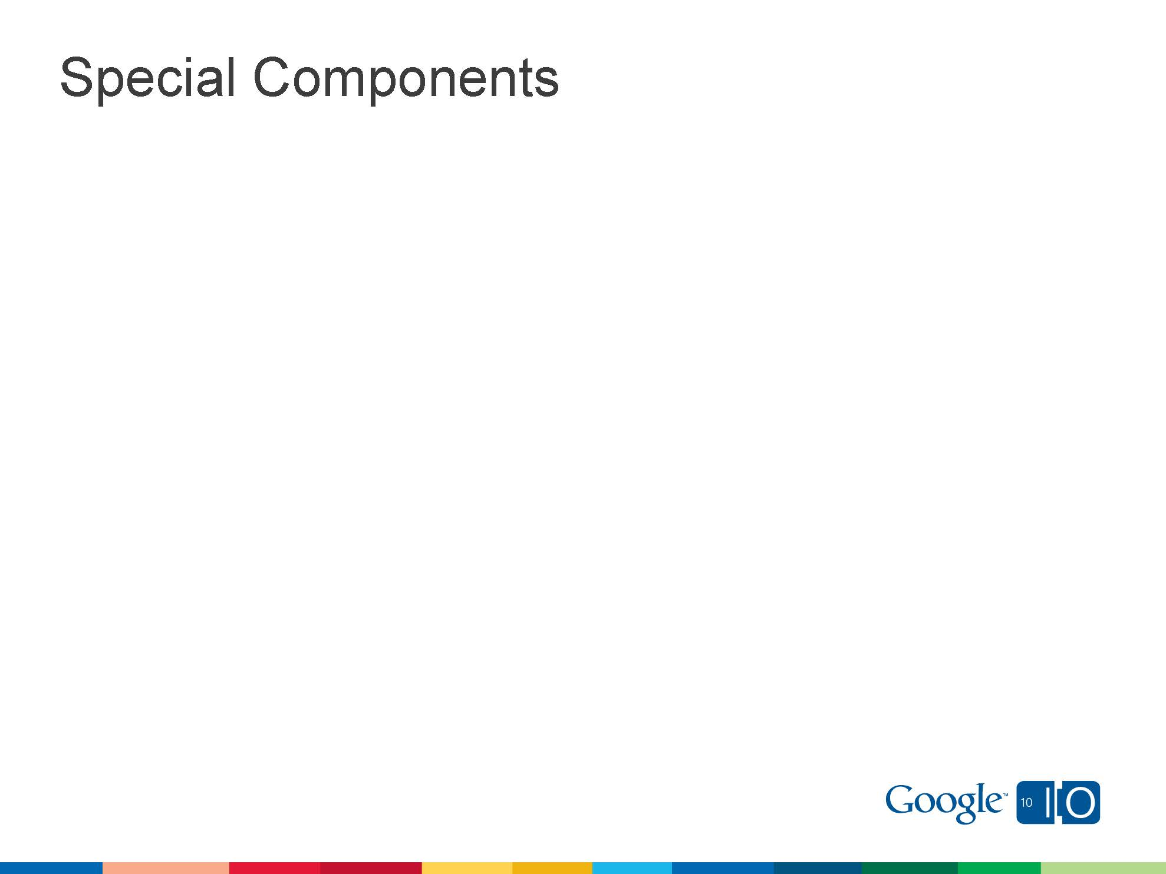

Slide 70
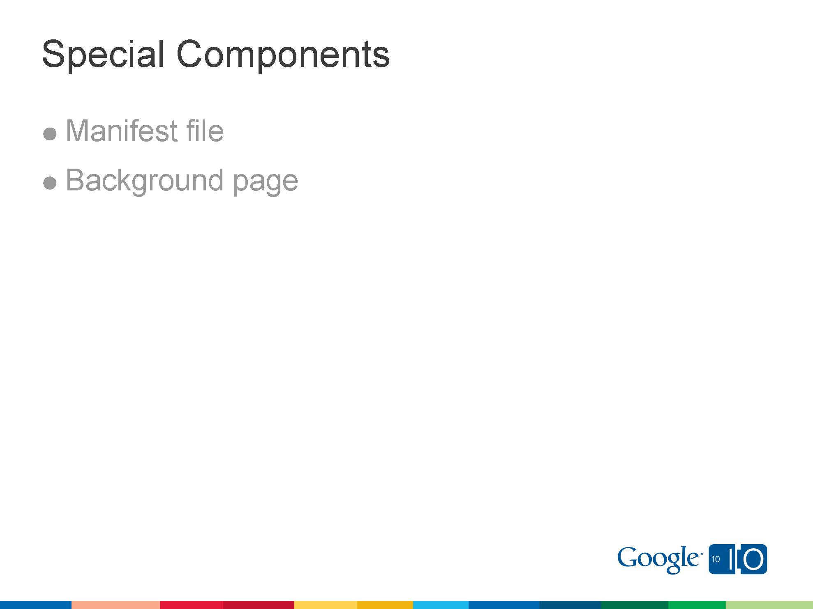

Slide 72
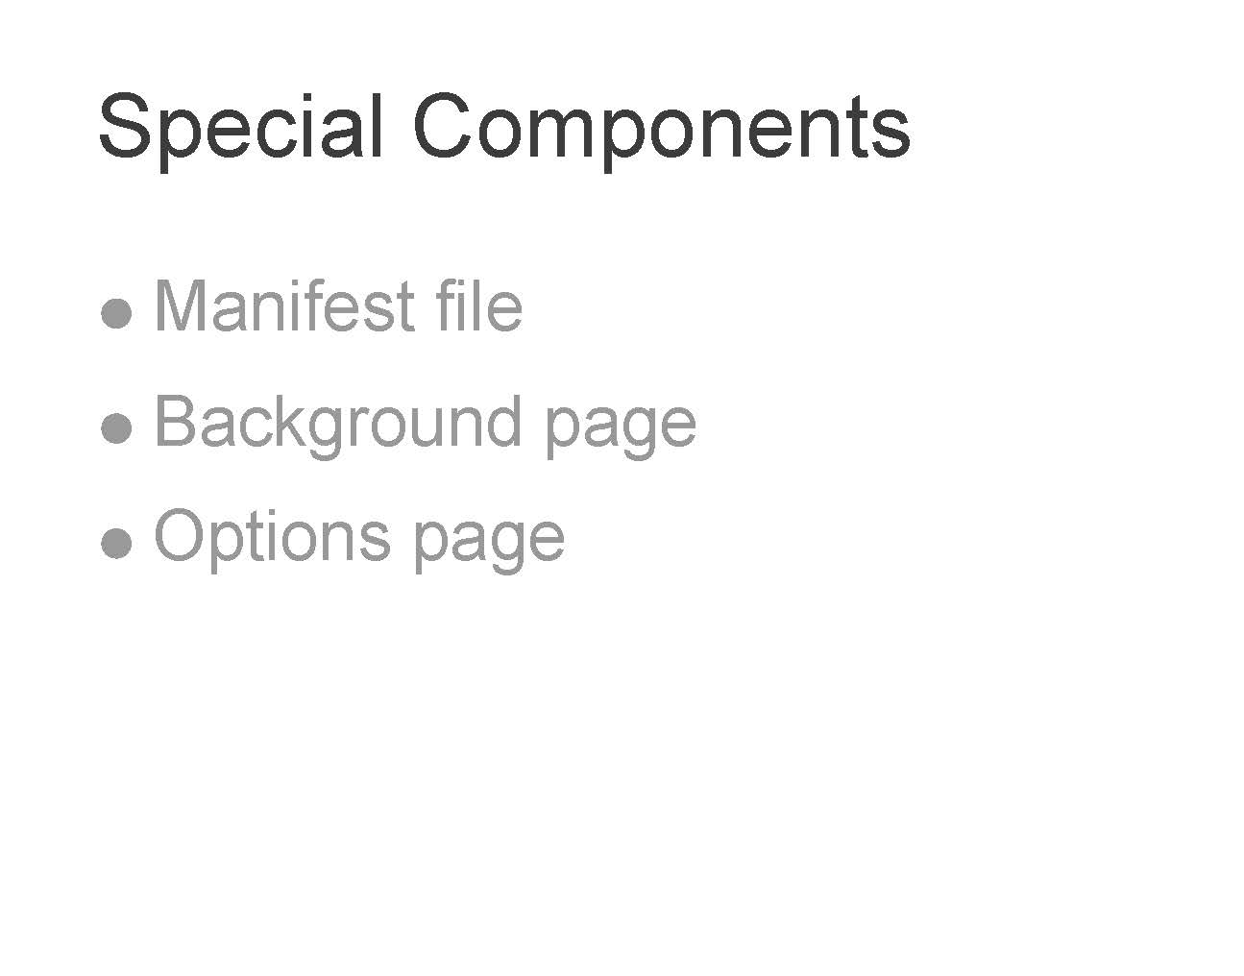

Slide 73
Useful functions
Store item in local storage.
Gets item from local storage with specified key.
Creating Logs.
Clearing local storage and logs.

Slide 74
Store item in local storage.
function setItem(key, value) {
try {
log("Storing [" + key + ":" + value + "]");
window.localStorage.removeItem(key); // Local storage
window.localStorage.setItem(key,value); // Local storage
}
catch(e) {
log("Error inside setItem");
log(e);
}
log("Return from setItem" + key + ":" + value);
}

Slide 75
Gets item from local storage with specified key
function getItem(key) {
var value;
log('Retrieving key [' + key + ']');
try {
value= window.localStorage.getItem(key); //Local Storage
}
catch(e) {
log("Error inside getItem() for key:" + key);
log(e);
value = "null"; }
log("Returning value: " + value);
return value;
}

Slide 76
Creating logs
function log(txt)
{
if(logging) {
console.log(txt);
}
}

Slide 77
Clearing local storage and logs
function clearStrg() {
log('about to clear local storage');
window.localStorage.clear(); // Local storage
log('cleared');
}

Slide 78


Slide 79
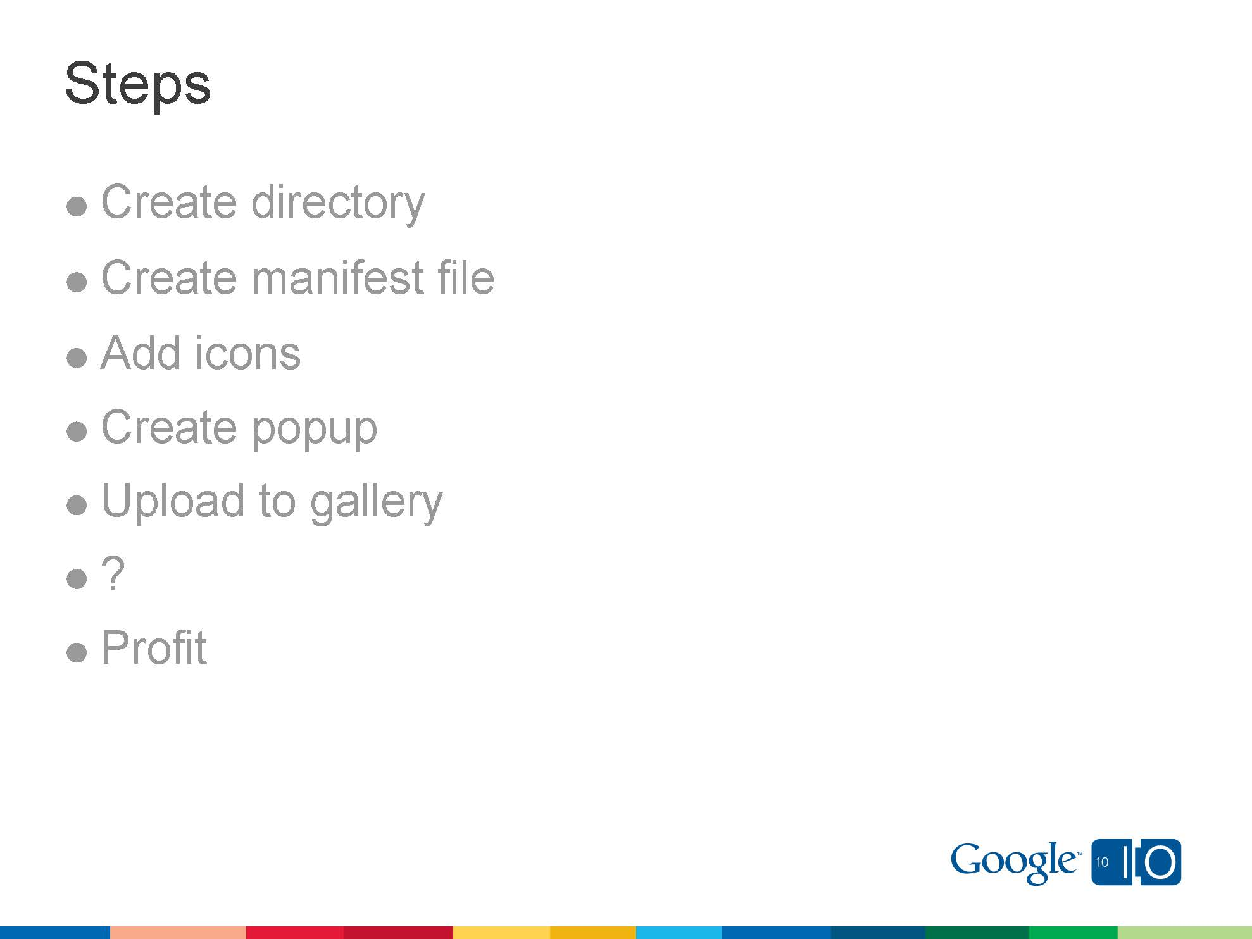

Slide 85
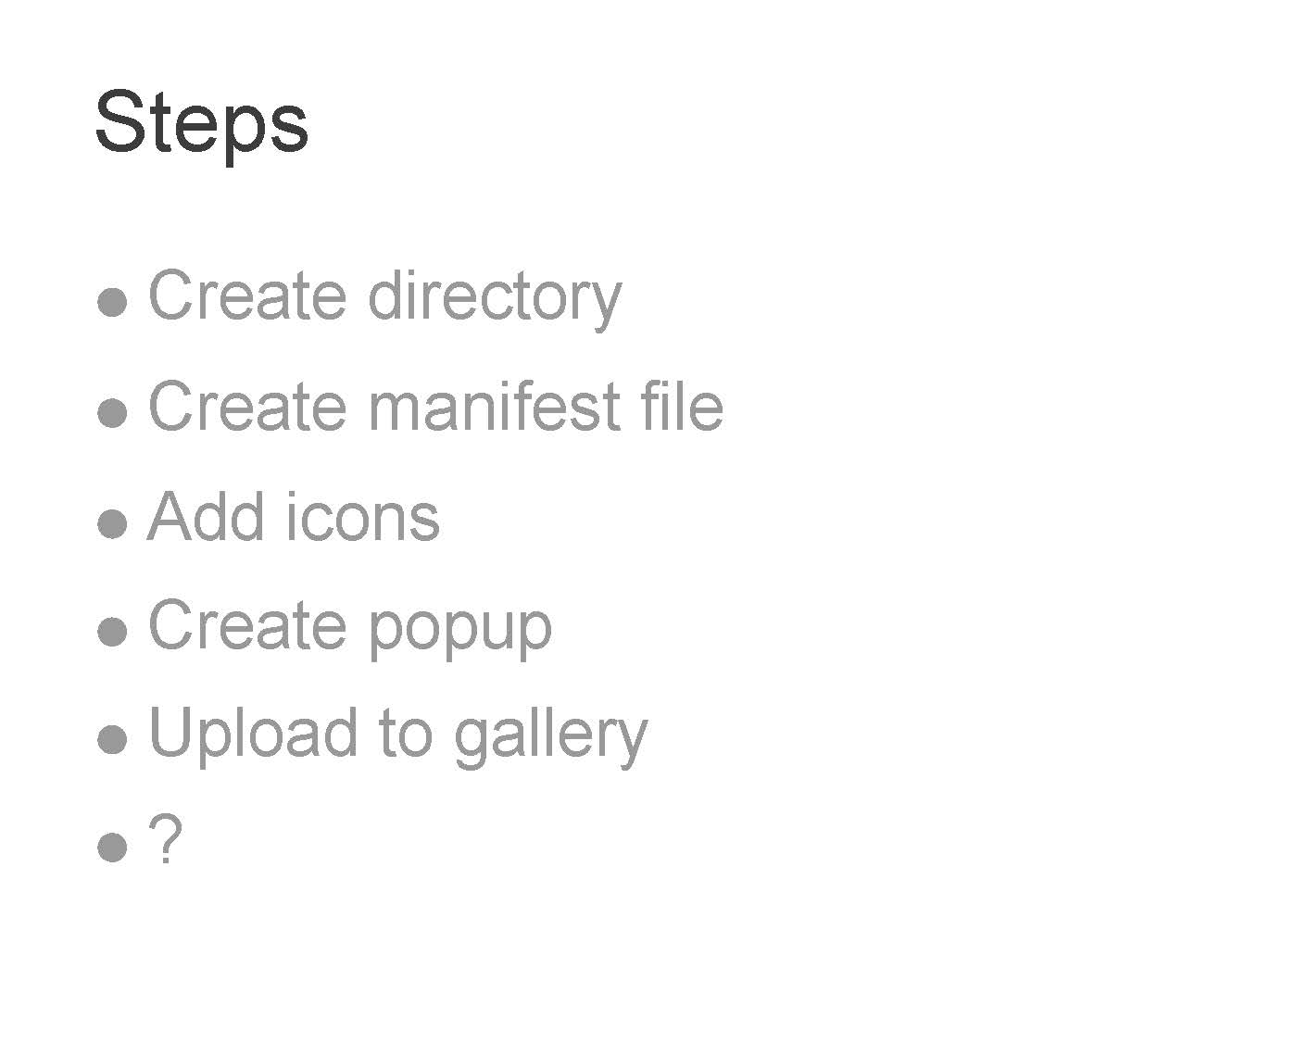

Slide 87
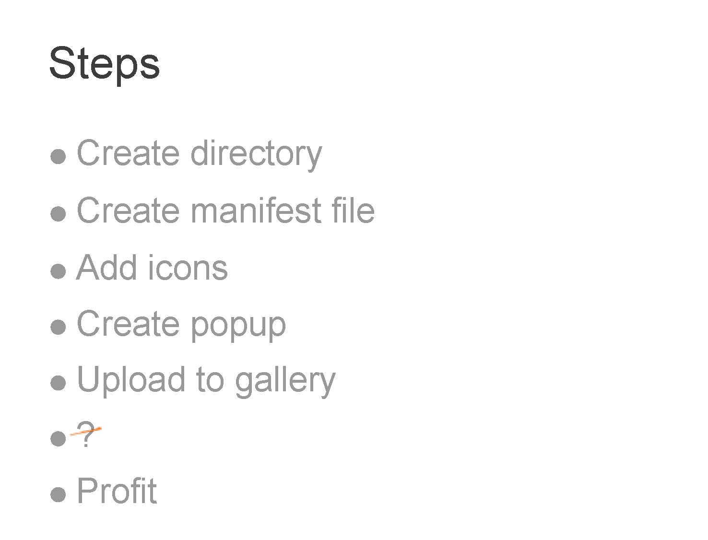

Slide 88
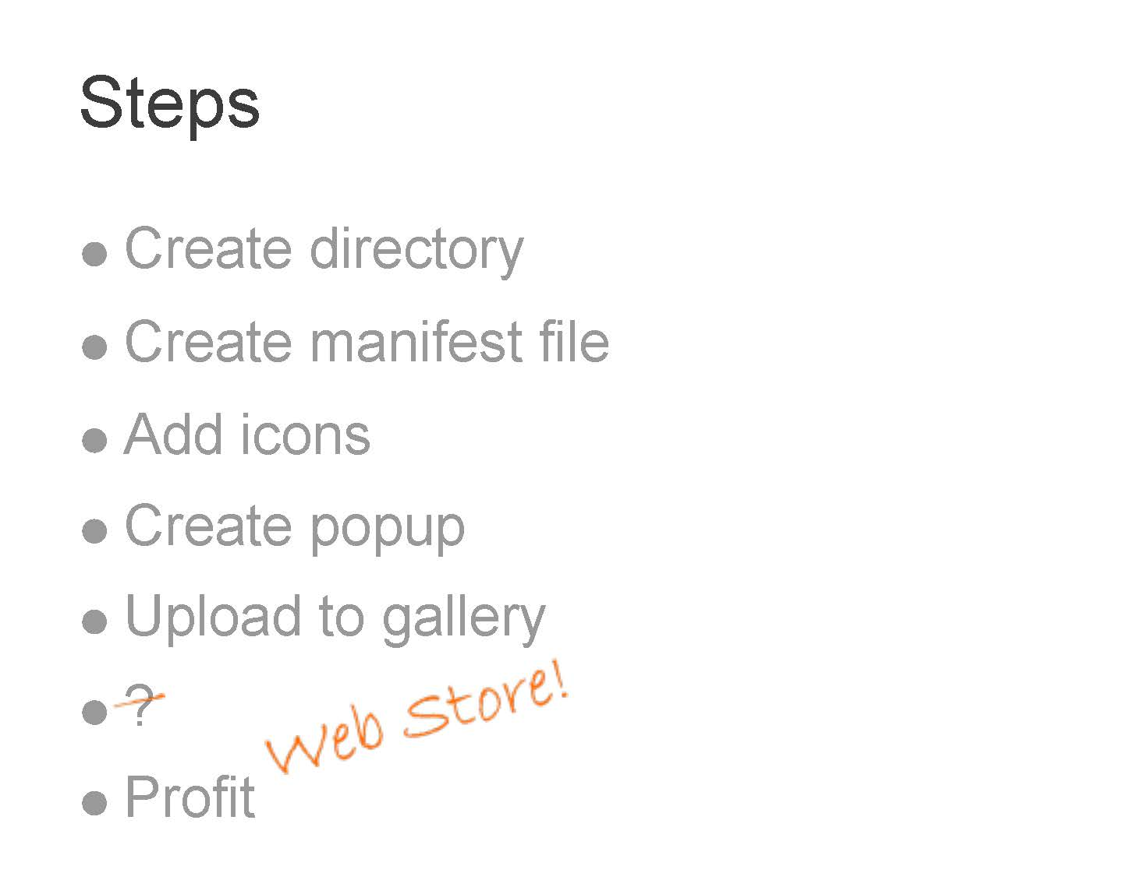

Slide 89
Create directory

Slide 90
Create directory
Create a folder anywhere in your pc

Slide 91
Create directory
Create a folder anywhere in your pc
Create a .json file using notepad and put the code inside. (json is abb. of javascript object notation.)

Slide 92
Create directory
Create a folder anywhere in your pc
Create a .json file using notepad and put the code inside. (json is abb. of javascript object notation.)
Put an icon for the extension.

Slide 93
Create directory
Create a folder anywhere in your pc
Create a .json file using notepad and put the code inside. (json is abb. of javascript object notation.)
Put an icon for the extension.
Put all your html, css, javascript files inside the respective folder

Slide 94
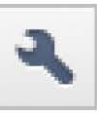
Create directory
Create a folder anywhere in your pc
Create a .json file using notepad and put the code inside. (json is abb. of javascript object notation.)
Put an icon for the extension.
Put all your html, css, javascript files inside the respective folder
Click on icon -> tools ->extensions

Slide 95
Create directory
Create a folder anywhere in your pc
Create a .json file using notepad and put the code inside. (json is abb. of javascript object notation.)
Put an icon for the extension.
Put all your html, css, javascript files inside the respective folder
Click on icon -> tools ->extensions
Expand developer mode -> click load unpacked extension button

Slide 96
Create directory
Create a folder anywhere in your pc
Create a .json file using notepad and put the code inside. (json is abb. of javascript object notation.)
Put an icon for the extension.
Put all your html, css, javascript files inside the respective folder
Click on icon -> tools ->extensions
Expand developer mode -> click load unpacked extension button
In file explorer, browse for your folder where you created files and click OK

Slide 97
Create manifest file
Manifest file (manifest.json)
{
//name of your extension
"name": "My First Extension",
//version of your extension
"version": "1.0",
//version of your manifest
"manifest_version": 2,
//description about the function of your extension
"description": "The first extension that I made.",
//involves all browser related interactions
"browser_action": { "default_icon": "icon.png" },
//sites which your extension is allowed to access
"permissions": [ http://*/*, ”https://*/*” ]
}

Slide 98
Create popup
This is the file which pops out when you click the extension icon in the browser. Put any html code here and you get the output in popup.
<html>
<font color=“red”>
Hello world!
</font>
</html>

Slide 99
Uploading extension
Go to https://chrome.google.com/webstore

Slide 100
Uploading extension
Go to https://chrome.google.com/webstore
Go to developer dashboard and sign in with your google account.

Slide 101
Uploading extension
Go to https://chrome.google.com/webstore
Go to developer dashboard and sign in with your google account.
Click add new item button

Slide 102
Uploading extension
Go to https://chrome.google.com/webstore
Go to developer dashboard and sign in with your google account.
Click add new item button
Browse for the file and upload it.

Slide 103
Uploading extension
Go to https://chrome.google.com/webstore
Go to developer dashboard and sign in with your google account.
Click add new item button
Browse for the file and upload it.
Enjoy !

Slide 104


Slide 105
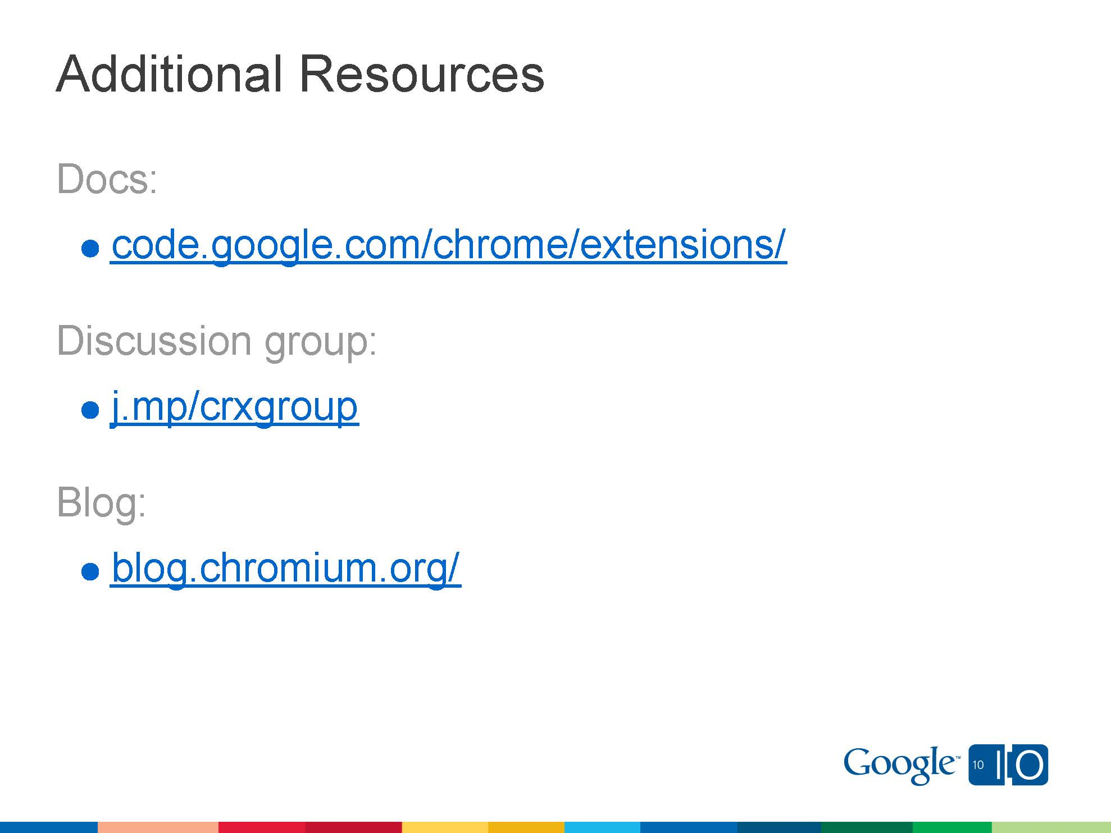

Slide 106
Thank You! (:
T.V. Vignesh 9535679593
Paramjot Singh
9740405365
Website: www.lugmanipal.org

